Slide 1


Can we improve on the present approach to diabetes treatment?
Precision Diabetes - the tailoring of diabetes treatment to the individual characteristics of the patient
Can we tailor second and third line treatment after initial Metformin using common clinical features?
Tailor to: non glycaemic benefit
avoid bad side effects
glucose lowering benefit

Slide 2
Precision Treatment: matching to patients characteristics
Choice of therapy altered by specific non glucose indications
Cardiovascular disease: SGLT2i or GLP1RA
Chronic Kidney Disease, Heart Failure SGLT2i
Choice of therapy altered by risk of known side effect
Avoid SU when risk of hypos is high
Avoid TZD when heart failure
Avoid SGLT2i when previous thrush or symptomatic urinary frequency/nocturia
NOT Choice of therapy altered by likelihood to lower glucose in that individual

Slide 3
Key hypotheses from clinical and trial data
Hypothesis 1 – BMI strata:
Patients with BMI>30kg/m², compared to patients with BMI<30kg/m², will achieve a lower HbA1c when assigned pioglitazone rather than sitagliptin
Hypothesis 2 – eGFR strata:
Patients with an eGFR 60-90 mls/min/1.73m² , compared to patients with an eGFR>90 mls/min/1.73m², will achieve a lower HbA1c when assigned sitagliptin rather than canagliflozin
Needs to be tested in a trial!

Slide 4
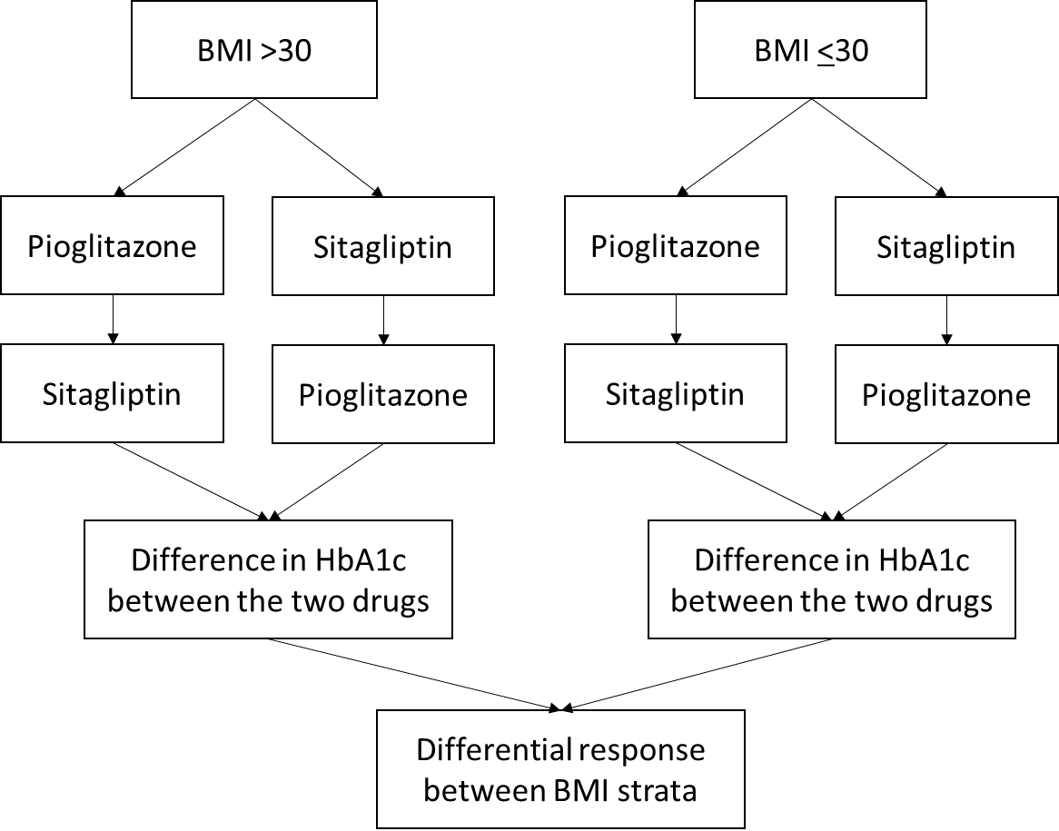
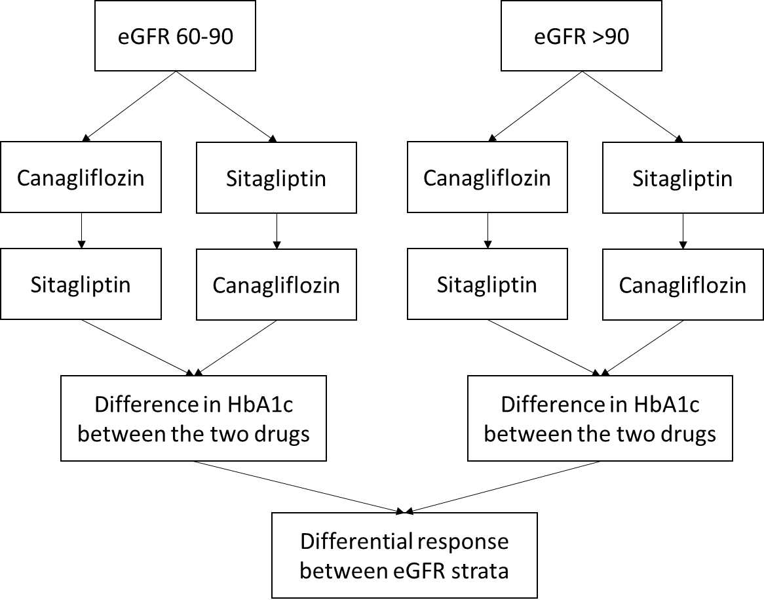
Hypothesis 1 – BMI strata:
Patients with BMI>30kg/m², compared to patients with BMI<30kg/m², will achieve a lower HbA1c when assigned pioglitazone rather than sitagliptin
Hypothesis 2 – eGFR strata:
Patients with an eGFR 60-90 mls/min/1.73m² , compared to patients with an eGFR>90 mls/min/1.73m², will achieve a lower HbA1c when assigned sitagliptin rather than canagliflozin
Sample size: To detect a 0.35SD difference between strata, 90% power, alpha=0.05:
N=344; increasing to N=520 for 60:40 strata split and to allow for withdrawals and exclusions

Slide 5
Trimaster: Three-way Crossover Trial to test both primary hypotheses
PERIOD 1
PERIOD 2
PERIOD 3
16 weeks
16 weeks
16 weeks
Pioglitazone
Pioglitazone
Pioglitazone
Type 2 diabetes,
Metformin only or Metformin &
Sulfonylurea,
HbA1c 58- 110mmol/mol
(7.5-12.2%)
Baseline visit
Randomised to one of six drug order sequences
Sitagliptin
Sitagliptin
Sitagliptin
Participant preference
Canagliflozin
Canagliflozin
Canagliflozin
Complete 16 weeks on each drug.
If don’t tolerate move on to next drug
No washout
HbA1c, Weight, patient reported side effects
HbA1c, Weight, patient reported side effects
HbA1c, Weight, patient reported side effects

Slide 6
Participant flow through the study
742 Screened
210 not eligible
7 withdrew
525 Randomised
22 withdrew
Valid HbA1cs needed for primary analysis
503 Assigned Drug 1
13 withdrew
29 < 12wks,
16 adh <80%,
1 missing
490 Assigned Drug 2
444 valid HbA1c for
Drug 1
Hypothesis 1 (BMI strata):
356 participants valid HbA1cs for pioglitazone & sitagliptin
Hypothesis 2 (eGFR strata):
342 participants valid HbA1cs for sitagliptin & canagliflozin
21 withdrew
40 < 12wks,
35 adh <80%,
2 missing
469 Assigned Drug 3
392 valid HbA1c for
Drug 2
11 withdrew
35 < 12wks,
34 adh <80%,
5 missing
458 Completed all 3 study periods
384 valid HbA1c for
Drug 3
1 did not provide data
457 visit 5
(pt preference)

Slide 7
Characteristics of 503 participants with baseline data
Variable | n (%) or Mean +/- SD or median (IQR)
Total subjects | 503
Male | 383 (73%)
Age at screening (y) | 61.9 +/- 9.5
Age at diagnosis (y) | 53.0 +/- 9.1
Treatment: Metformin only Metformin + SU | 254 (48%) 271 (52%)
Ethnicity: White Mixed Asian Black Other Not Stated | 495 (94%) 2 (0.4%) 16 (3%) 3 (0.6%) 4 (1%) 5 (1%)
BMI (kg/m²) BMI>30 n (%) | 31.7 +/- 5.5 307 (58%)
eGFR (mls/min/1.73m²) eGFR>90 n(%) | 89.7 +/- 13.8 275 (52%)
HbA1c at screening (mmol/mol) | 69 (63, 78)

Slide 8
With no stratification, there was no overall difference in HbA1c between the three therapies
Baseline HbA1c
(n=421)
(n=391)
(n=408)

Slide 9
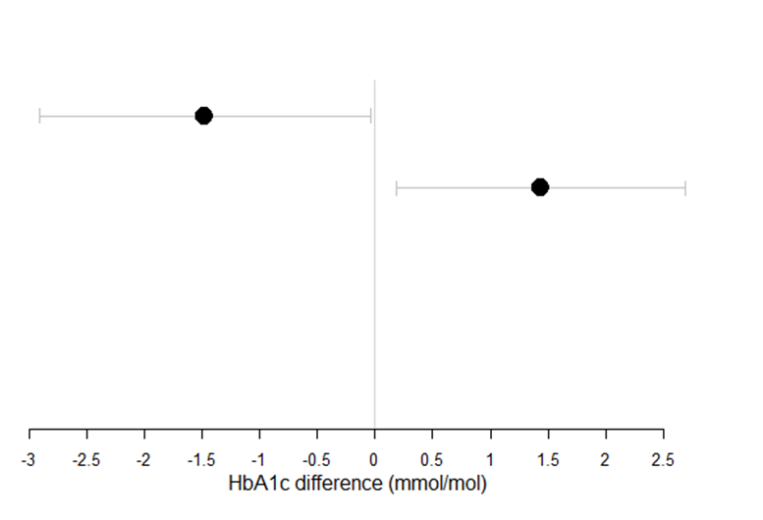
Hypothesis 1
Participants with BMI<=30 have a lower HbA1c on pioglitazone whereas participants with BMI>30 have a lower HbA1c on sitagliptin
BMI<=30 (n=141)
BMI>30 (n=215)
Overall difference between strata: 2.92 (95% CI 0.99, 4.85) mmol/mol
Favours sitagliptin
Favours pioglitazone

Slide 10
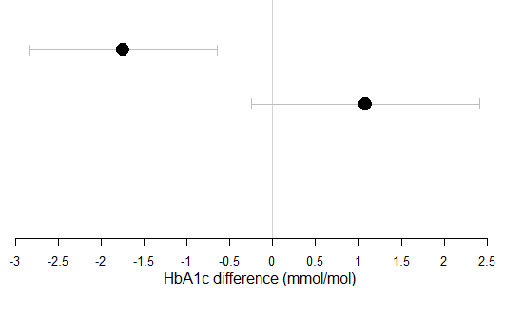
Hypothesis 2
Participants with eGFR 60-90 have a lower HbA1c on sitagliptin whereas participants with eGFR>90 have a lower HbA1c on canagliflozin
eGFR 60-90 (n=163)
eGFR >90 (n=179)
Overall difference between strata:
2.83 (95% CI 1.09, 4.55) mmol/mol
Favours sitagliptin
Favours canagliflozin

Slide 11
Summary – Differential Response by Strata
Both prior hypotheses confirmed
  BMI>30kg/m² – lower HbA1c on pioglitazone
  BMI<=30kg/m² - lower HbA1c on sitagliptin
  eGFR >90mls/min/1.73m² – lower HbA1c on canagliflozin
  eGFR 60-90mls/min/1.73m² – lower HbA1c on sitagliptin
Choosing treatment according to strata would lead to ~3mmol/mol overall difference in achieved HbA1c
No difference in secondary outcomes by drug/strata combinations except weight higher with pioglitazone if BMI>30kg/m²

Slide 12
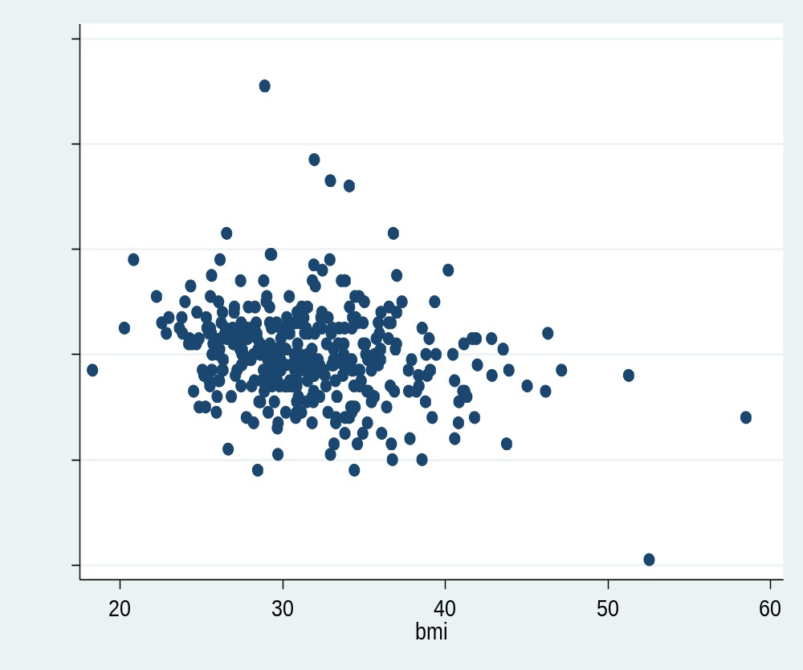
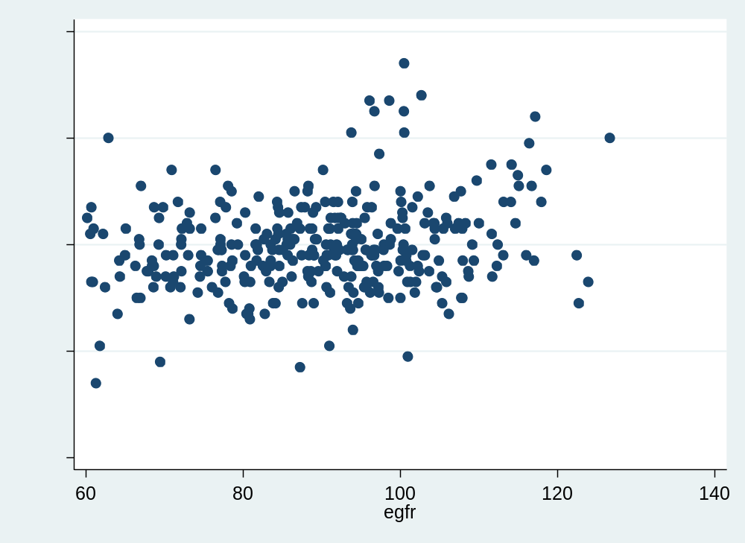
Linear relationship means extreme BMI or eGFR will have a greater impact on differential treatment response
HbA1c
difference
mmol/mol
Positive values favour Sita
HbA1c
difference
mmol/mol
Positive values favour Cana
Negative values favour Pio
Negative values favour Sita
BMI
Kg/m2
eGFR ml/min/1.73m2

Slide 13
Analysis Part 2:
Participant Preference

Slide 14

The crossover design enabled participants to compare their own experience on each of the three drugs
Patient on
Metformin only or Metformin and
Sulfonylurea with
HbA1c >58mmol (7.5%)
and ≤ 110mmol/mol (12.2%)
4 months
DPP4i or
SGLT2i or
TZD
4 months
DPP4i or
SGLT2i or
TZD
4 months
DPP4i or
SGLT2i or
TZD
Patient preference
458 patients receiving 3 different medications, double blind (over capsulated)
allows unique within patient comparison of side effects, tolerability and preference.
Effectively “n of 1” trial patient tries 3 medications and selects preferred drug.
Directly compare benefits v disbenefits of different treatments for them.
Blinded analysis means bias free assessment of side effects and their prevalence

Slide 15
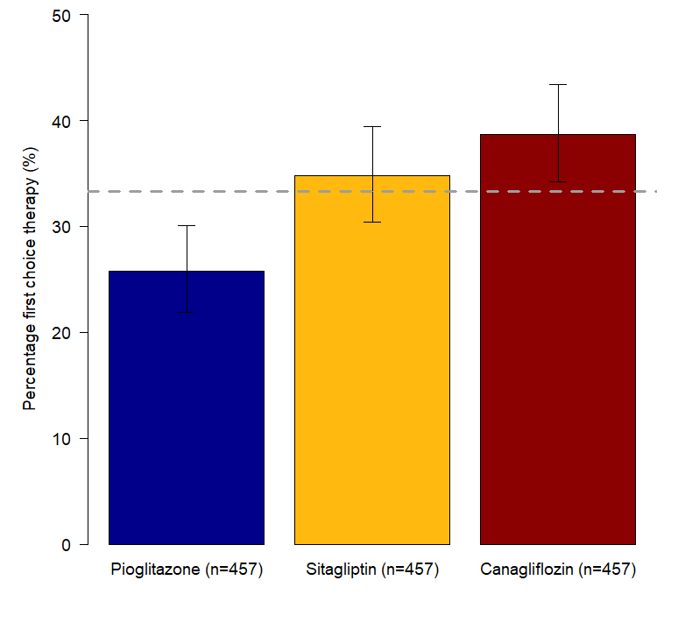
Secondary analysis: participant preference split 26-39%
Line of equality of all drugs equally preferred
25.8%
34.8%
38.7%

Slide 16
The preferred drug was associated with the lowest HbA1c
Prefer Pioglitazone
Prefer Sitagliptin
Prefer Canagliflozin
(n=118)
(n=159)
(n=177)

Slide 17
The preferred drug was associated with fewest side effects
Prefer Pioglitazone
Prefer Sitagliptin
Prefer Canagliflozin
(n=118)
(n=159)
(n=177)

Slide 18
Regardless of preference, pioglitazone was associated with the highest weight on therapy
Prefer Pioglitazone
4
Prefer Canagliflozin
Prefer Sitagliptin
(n=118)
(n=159)
(n=177)

Slide 19
Summary – participant preference
Participant preference was not all one drug - preference was 26% pioglitazone, 35% sitagliptin, 39% canagliflozin
Preference associated with lower HbA1c and fewer side effects
Further exploration of these data in future along with qualitative analysis of participant questionnaire responses and free text feedback

Slide 20
We can improve on the present approach to diabetes glycaemia treatment by a Precision Medicine approach
Precision Diabetes – can help tailor glucose lowering diabetes treatment for individual characteristics of the patient
Patients prefer therapy based on their glucose control and their side effects- this is different for different people.

