Slide 1
What makes a good research proposal?
Angela Shore
Scientific Director, NIHR Exeter CRF.

Slide 2

We all do research
Make
Model
Miles to the gallon
Head height

Slide 3
Academic research
Controlled
Rigorous, strict procedures to follow
Valid and verifiable approaches used
Critical scrutiny of why its being done and how
Systematic and Challengable—based on research gaps, clear data collection plan and statistical analysis plan

Slide 4
The research proposal
Different lengths: 2-60 pages
Differences in what we expect from a proposal related to their uses
  Justify use of anonymised data
  Justify use of donated blood samples (Exeter 10000)
  Justify to a funding body (charity, medical research council, university) why their money should be spent on this project and not others
The latter is the biggest most formal proposals – the aspect I will cover here

Slide 5
Research proposal / protocol development
Proposal development
Internal scientific review
Review by internal academic peers: Originality, priority, feasibility and whether message is clear
Submitted to funding body e.g. Wellcome Trust or Diabetes UK
Reviewed by external peer reviewers and patient advisory board. Reviews fed back to grant awarding committee who have the final say on funding.
Input from research team, statisticians, clinical team and PPI representatives

Slide 6
Assessing the research proposal
External peer review: Different perspectives:
Academic expert, Statistics expert
Patients and Carers-
How are patients affected by this condition?
How can the research improve patients quality of life?
Do people with this condition support this research?
Healthcare professionals-
If successful would it be do-able in the NHS?
Would it improve treatment of patients?
Would it save the NHS money?

Slide 7
What makes a good research proposal?
Some common principles to all proposals but proposals differ:-
A good student PhD research proposal will differ from a full grant application to a grant funding body eg in its breadth, the size of the question, the funding (£60K versus £300K or £several millions)
Some good research proposals are first steps for a new approach for example they might be testing a new method on blood samples, just because they are first steps dosent mean they are any less important.
Some good research proposals are designed to see if something is actually possible to study (feasibility studies), they don’t answer the final research question but are also the first step to answering the question.
Research in different specialities write proposals differently

Slide 8
What makes a good research proposal?
Project
People
Place
3 P’s

Slide 9
Assessing the Project (1)
1. The research question or aim
Must fill a gap in what is known—be original or justify why not
Must not be too broad or big –ie it must be do-able
For clinical research must have involved patients, public, carers

Slide 10
The research question or aim: originality
The introduction to the project should set the scene.
Why is inflammatory bowel disease an important area for research, how are patients affected, what is the cost to the NHS?
Which particular aspect are they interested in and why?
What research has been done in this area to date-review the literature critically?
What are the gaps in knowledge
This leads to the research question or aim which is designed to fill one of the identified knowledge gaps,

Slide 11
The research question or aim: originality
Example research question: Does insulin lower blood glucose?

Slide 12
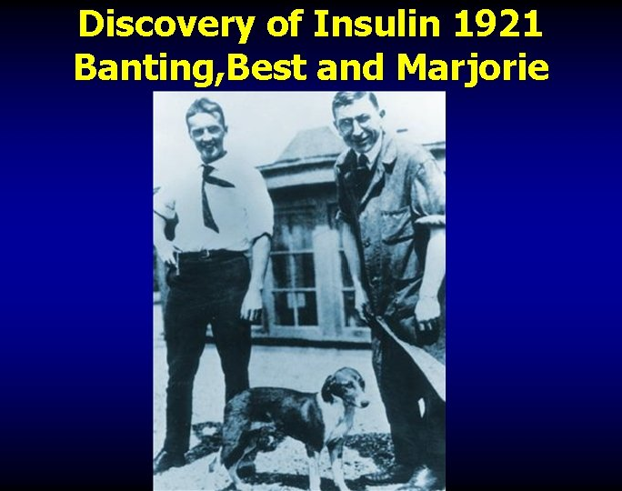
Not original research question today
~30 Million patients with Type 1 diabetes use insulin every day

Slide 13
The research question or aim: originality
Much is still unknown:-
  about lowering blood glucose in the body and
  about the actions of insulin other than in the pancreas?
  Example research question:
  Does insulin act on the endothelial cell X receptor (cell handle) to cause blood vessels to vasodilate (get bigger).

Slide 14
The research question or aim: do-able
The research question needs to be do-able.
Research question: Do human brain cells increase levels of LOX74 in response to dietary supplementation with carrot juice.
Not do-able– cannot take brain biopsies to get cells after the participant has taken the dietary supplement, needs to be realistic. Also needs to be SMART.
Research question: Does 4 weeks of dietary supplementation with 300ml carrot juice/day compared to normal diet, increase brain activity as determined by a 20% increase in EEG beta waves (brain electrical activity).
Notes:
The latter could be done. Now the questions I am thinking relate to, is the topic well justified in the introduction, ie that carrot juice might have a role, that beta waves are the way to assess brain function, how they will do this. What is the design of the investigation? Are these healthy controls or people with a condition, young or old etc. Is 20% change in beta wave every seen is it realistic, Will people volunteer to come in to have EEGs. Will they drink 300mls carrot juice a day. Will they avoid carrots in normal diet or record normal carrot intake, how many people will they assess and why

Slide 15
The clinical research question or aim: PPIE
What makes a good clinical research question/aim:
Maybe based on a research priority identified by patients –if one is available eg James Lind alliance priority setting
Has actively engaged with patients, carers, public in the development of the question, its something that is supported by these peolpe and by health care professionals
Has actively engaged with patients, carers, public in the design of the study and how it will be delivered and its clearly documented in the proposal.

Slide 16
Methods section: Study design
Clinical interventional study eg drug or exercise or mindfulness training
  Do they allocate participants to intervention or no intervention (control) in a randomised way?
  Do they know who gets what?
  Is it a double blind randomised controlled trial? If not why not?
  Is the intervention based on good evidence?
  Is the outcome measure clear and appropriate? Outcome measure is the way they will assess the thing they are interested in affecting eg Blood pressure or fitness or anxiety level.

Slide 17
Methods section: Study design
Experimental medicine study eg taking a sample of muscle to assess something or taking a brain scan or taking blood samples to measure a biomarker
Research question: Do the type of muscle fibres (fast or slow twitch) differ in people with type 2 diabetes compared to people without diabetes and contribute to differences in exercise capacity?
  Are the participant groups justified (why do they want muscle/scan/blood from these specific people)
  Is the control group appropriate
  Are they adjusting for appropriate confounding measures eg exercise, cognitive ability, length of diabetes, complications of diabetes, co-morbidities
  Are the participants appropriated assessed so that they can relate the cell characteristics to the participant eg how will they assess exercise capacity,

Slide 18
Methods: Laboratory aspects
Assessing study proposals is not just about the participants and clinical design its often about what they will do with samples going to the lab or even how images are analysed etc.
Have they justified what will they do with the muscle/image/blood and why?
Is it a proven technique and do they have the expertise?
If not proven is there pilot data to prove it works?
Are there appropriate controls?
Are they repeating the experiments enough?
Do they tell us how variable the technique is in their hands?
Is the muscle being examined in appropriate conditions eg in glucose levels of a person with diabetes or in an oxygen level that’s appropriate

Slide 19
Methods: Sample size--crucial
Number of people being studied= sample size:
There need to be sufficient people being studied so that if the results are negative it really does mean there is no effect of the drug intervention or no difference in the muscle cell function between the two groups- not just that they did not study enough people to show a difference.
How can they (and assessors) be sure enough people are studied?
  Use literature or pilot data to see what kind of difference between groups or with treatment might be expected
  If clinical, use expertise and literature to decide what is a clinically useful difference
  Use this information with statisticians to work out the number of people needed per group to complete the study (a sample size calculation)
  Show how this is calculated in the proposal

Slide 20
Methods: Sufficient specimens--crucial
Not just number of people being studied also the number of samples taken from the subject
E.g So is one muscle sample enough? How have they justified it.
  They show that the measurements they are doing on it are very repeatable so one muscle sample is sufficient
  They show that if they take two muscle samples from a person they get the same or sufficiently similar result
  Or they show that they take subsamples from a single muscle sample and show that if they do their assessments 3 times on that single muscle sample then they get a value which is reproducible and representative of that person

Slide 21
Methods: Sample size--crucial
Is recruiting the number of participants realistic?
How many of these patients are there in their area?
Have patients been approached to see if they support and are likely to volunteer?
Have patients and carers being involved in the design?
Is it too onerous design eg many muscle biopsies? Has this been taken into account in drop out numbers
Is the plan on how to recruit participants, rate of recruitment etc realistic?

Slide 22
What makes a good research proposal?
Project
People
Place
3 P’s

Slide 23
Peolpe
Assess whether they have the appropriate people included in the proposal in order to ensure its conducted properly
Eg: if in diabetes –a diabetologist, maybe a podiatrist (for a foot project),
Eg patients with the condition and their carers
Eg a statistician at minimum to advise on design, sample size and data analysis –for some complicated studies statisticians analyse the studies
Eg for a drug trial there are specific committees that need to be in place :- a data management committee, a steering committee and each must be made up of appropriate people
Eg a geneticist or cell biologist with the right skills for the lab part
Eg a physicist or image analyst for the MRI images

Slide 24
What makes a good research proposal?
Project
People
Place
3 P’s

Slide 25
Place
This dosent mean it has to be done in an outstanding academic institution say Oxford.
But the place has to be appropriate for the study and have all the facilities or access to them.
Eg an MRI scanner, a clinical research facility or other area that participants can come into and skills to able to do muscle biopsies or whatever is needed in the study
Experience in doing the e.g exercise tests (or a plan to get that expertise)
A reputation for recruiting participants to these type of studies

Slide 26
Research proposal / protocol development
Project worked up for ethical approval
For example, proposal transformed into study protocol
Development of participant facing literature (e.g. participant information sheet, consent form) - PPI input
- Submit all relevant documents including evidence of independent scientific review to the REC.
- REC ethical (not scientifically) review the application, for example, they evaluate whether the potential participants are fully informed what participation involves, including the risk and benefits.
Submitted to a Research Ethics Committee (REC)

Slide 27
Assessing the proposal from a PPI point of view
Lay summary clear and understandable,
Research question and objectives clear and seems do-able from a PPI point of view and PPI involved in developing the research question
Patients and carers involved in the design of the project
Patients and carers going to be involved in the project
Patients with the condition support the proposal
Plan that describes how they will tell patients about the results, clear, appropriate for the age of the patient population with the disease eg social media, WI, charity PPIE committees.
Patients and carers involved in dissemination plan
People and place appropriate for the study

