Slide 1
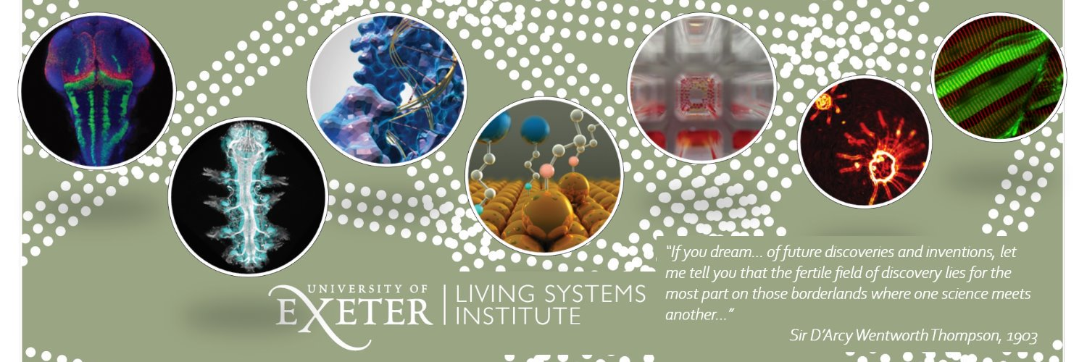
Stem Cells & Medicine
Austin Smith
www.exeter.ac.uk/livingsystems

Slide 2
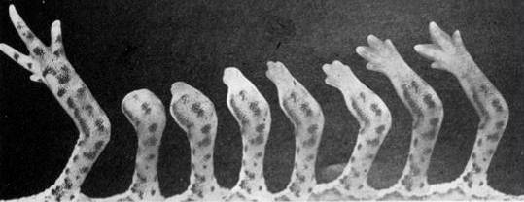

Slide 3
An adult requires 100,000,000,000 new blood cells every day
Tissue Renewal in Humans
Entire intestine is renewed each week; skin surface is replaced every two weeks
Billions of sperm cells are produced throughout life

Slide 4

Stem cells
Self-Renewal
Differentiation
Notes:
4

Slide 5













Differentiated cells
Stem cell
Transit amplifying progenitors
Maintenance
Production (massive)
Function
T-Cell
T-cell precursor
B-Cell
CLP
B-cell precursor
Macrophage
Neutrophil
CFU-GM
MLP
Eosinophil
CFU-Eosin
Erythrocyte
CMP
BFU-E CFU-E
Platelets
CFU-MEG
Basophil
CFU-Bas

Slide 6
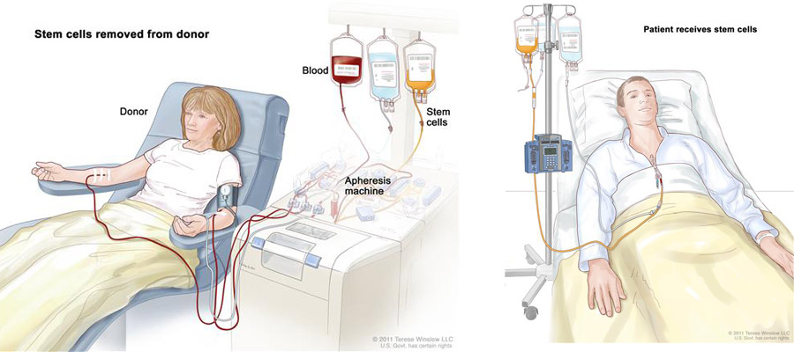
Blood Stem Cell Transplantation
Blood stem cells cannot (so far) be expanded out of the body. They are transferred directly from a matched donor to the patient (allogeneic transplant). Risk of immune reaction.

Slide 7
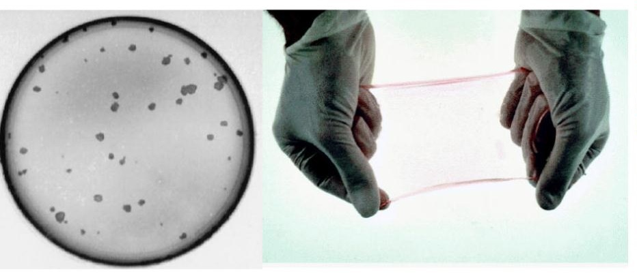
Skin stem cells grow and make skin in the laboratory
Colonies growing from single skin stem cells
Notes:
7

Slide 8
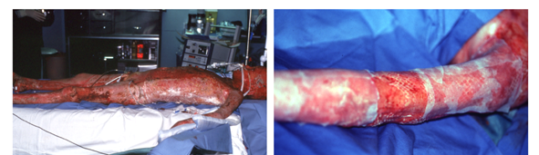
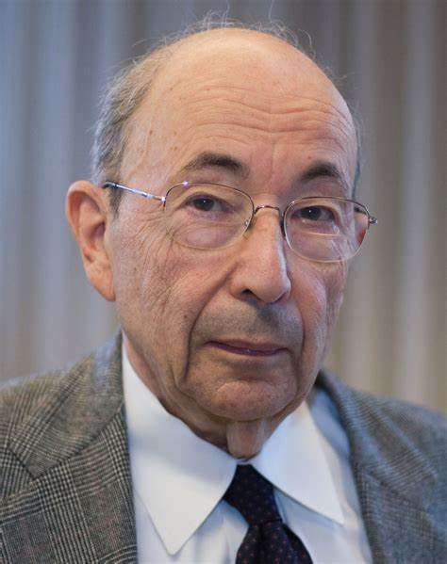
Permanent coverage of large burn wounds with autologous cultured human epithelium
Gallico et al. N Engl J Med (1984)
Howard Green and colleagues
Notes:
8

Slide 9
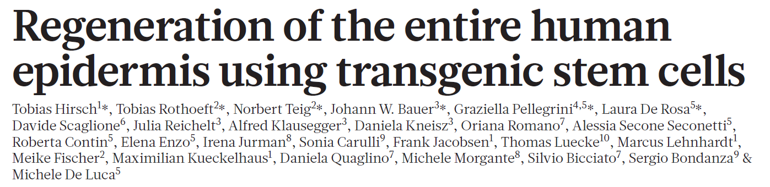
Combined Stem Cell and Gene Therapy
Hirsch et al, Nature, 2017
Junctional epidermolyis bullosa
chronic and ultimately lethal skin blistering;
caused by loss-of-function mutation in laminin gene, LAMB3.

Slide 10
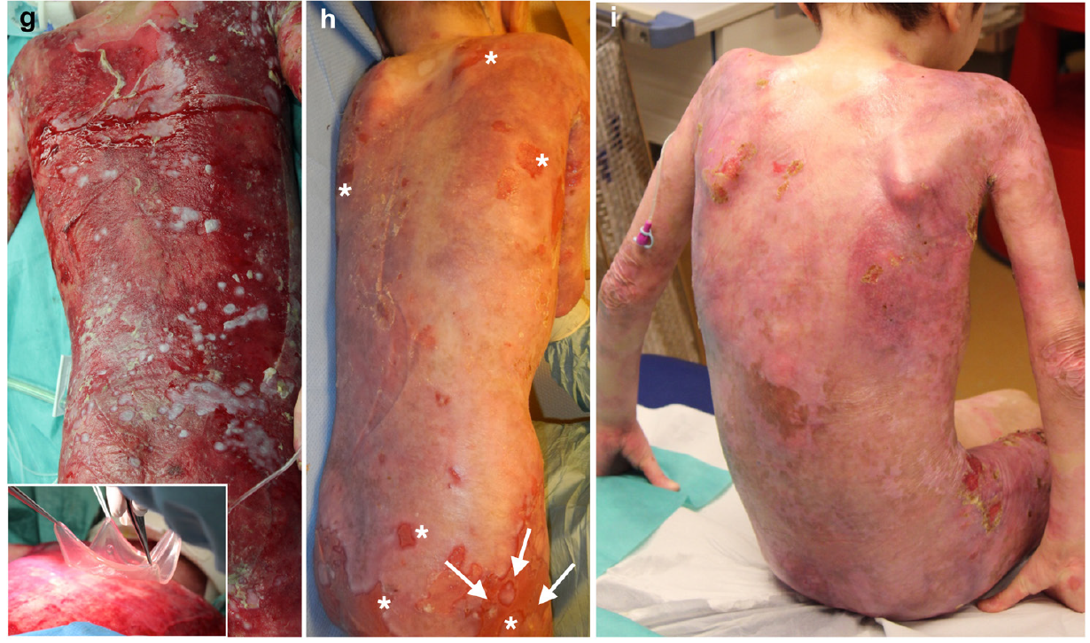
Before and after
1 month
4 months

Slide 11

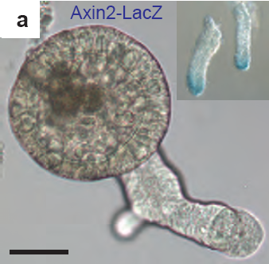
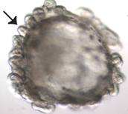
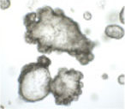
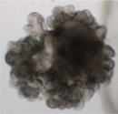
Stem Cell Organoids
Colon
Stomach
Liver
Pancreas

Slide 12
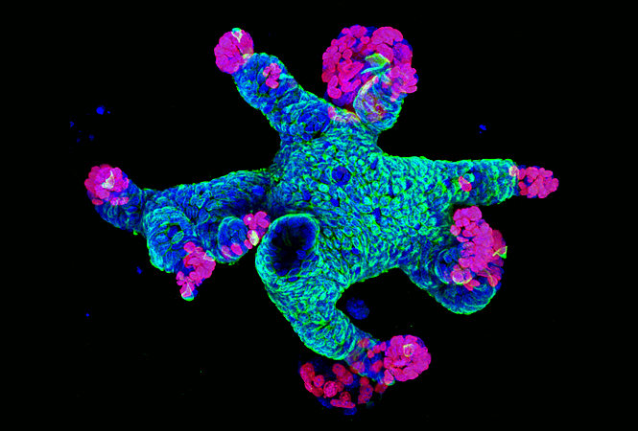
Intestinal Minigut Organoid
from Gerald Schwank

Slide 13
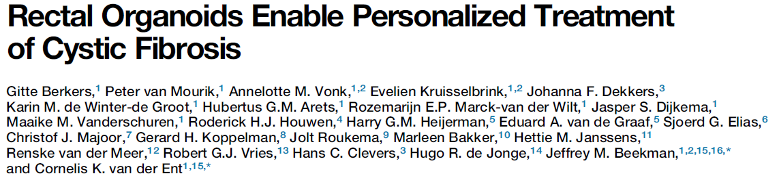
How are organoids used in medicine?
Biobanks of normal and cancer tissue for:
  disease stratification based on phenotypes and genomics
  mechanistic studies
  drug screening
Personalised medicine:
  - screen available drugs on patient organoids
Cell Reports, 2019
Transplantation:
  – still futuristic (requires advanced tissue engineering and microsurgical technologies)

Slide 14
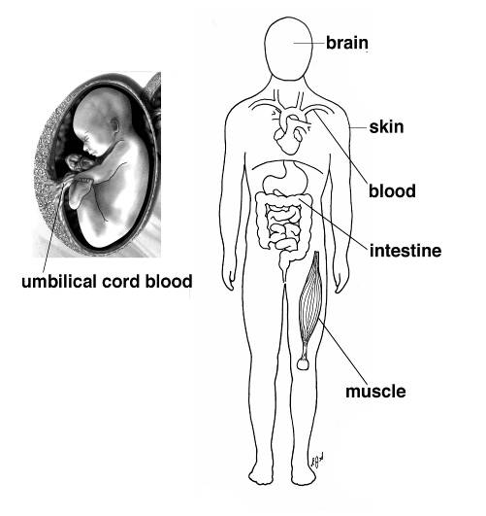
Adult Tissue Stem Cells
cornea
Maintain individual tissues
Do not make cell types of other tissues
testis
Are not present in some tissues e.g. brain and heart

Slide 15
PLURIPOTENCY
One cell for all

Slide 16
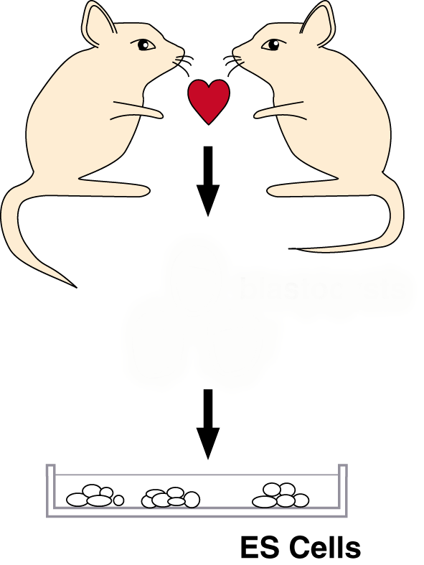
In 1981 ….
Evans & Kaufman, 1981
Martin, 1981

Slide 17
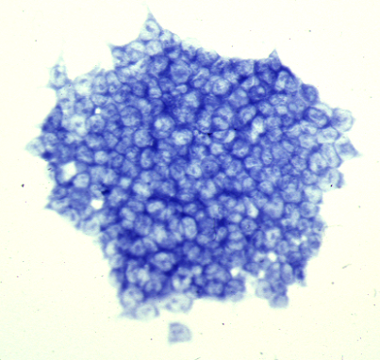
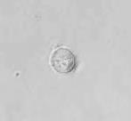
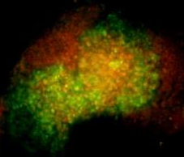
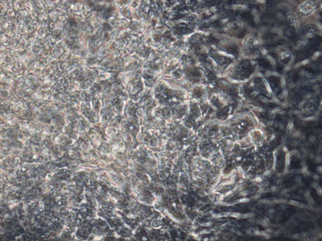
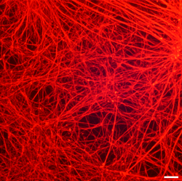
Embryonic Stem Cells are Pluripotent
Endoderm
Mesoderm
Ectoderm

Slide 18
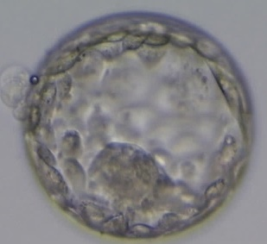
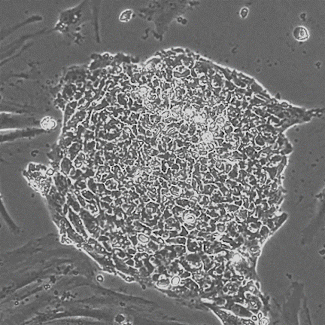
Human Pluripotent Stem Cells
Thomson et al., Science, 1998
Day 6 human embryo
Similar to mouse embryonic stem cells

Slide 19
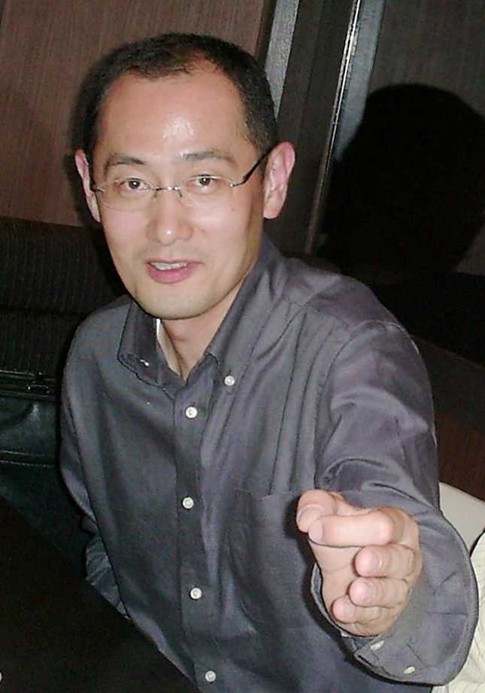
Molecular Reprogramming
Skin cells
Shinya Yamanaka
Pluripotency
genes
Induced pluripotent stem cells

Slide 20
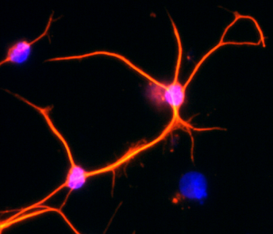
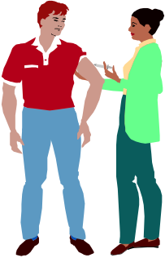
Human pluripotent stem cells
Donated embryos
Disease models
_{Stem Cell}
_{Factor}
Skin
β cells
Drug discovery
Blood
Molecular reprogramming
Patients

Slide 21
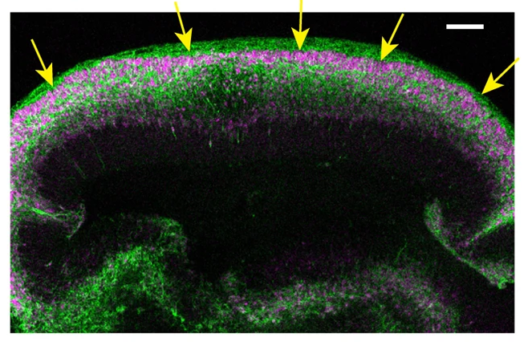
Brain organoids from human pluripotent stem cells
Guided
differentiation
Lancaster et al., 2017
Huge potential for modelling disease and testing drugs

