Slide 1

Long COVID
The sting in the tail
Dr. David Strain
D.Strain@Exeter.ac.uk
@DocStrain
Diabetes and Vascular Research Centre,
University of Exeter Medical School, UK

Slide 2
Disclaimer
“I would never allow a scientist to partake in my government –
Give them a new piece of information and they are liable to change their mind”
Abraham Lincoln
16th President of the United States

Slide 3

Covid Recovery…?
Large previous pandemics were associated with post viral illness
Prior to COVID-19, there was a well documented association between the 1918-20 flu pandemic and encephalitis lethargica
This saw the discovery of L-Dopa
It was anticipated COVID would have sequelae…
Notes:
Oliver Sachs
1973

Slide 4
Long COVID
Early in the pandemic people were reporting slow and incomplete recovery.
First Publication - August 2020
  76% of people hospitalized in Wuhan still had symptoms after 6 months
  Not all of these symptoms were from the initial disease
The term “Long COVID” was already in circulation
Notes:
May 2020 as a hashtag on Twitter by /, an archaeologist at University College London.

Slide 5
Diagnostic criteria
Three clinical syndromes
Acute COVID-19 - first 4 weeks after infection
New or ongoing symptoms 4 weeks or more after the start of acute COVID-19, further divided omtp:
  ongoing symptomatic COVID-19 for effects from 4 to 12 weeks after onset, and
  post-COVID-19 syndrome for effects that persist 12 or more weeks after onset.
NICE definition of long COVID
  "commonly used to describe signs and symptoms that continue or develop after acute COVID-19. It includes both ongoing symptomatic COVID-19 (from 4 to 12 weeks) and post-COVID-19 syndrome (12 weeks or more)"
Notes:
which it uses "in addition to the clinical case definitions", NICE defines post-COVID-19 syndrome as "Signs and symptoms that develop during or after an infection consistent with COVID‑19, continue for more than 12 weeks and are not explained by an alternative diagnosis. It usually presents with clusters of symptoms, often overlapping, which can fluctuate and change over time and can affect any system in the body. Post‑COVID‑19 syndrome may be considered before 12 weeks while the possibility of an alternative underlying disease is also being assessed".^{[20]}

Slide 6
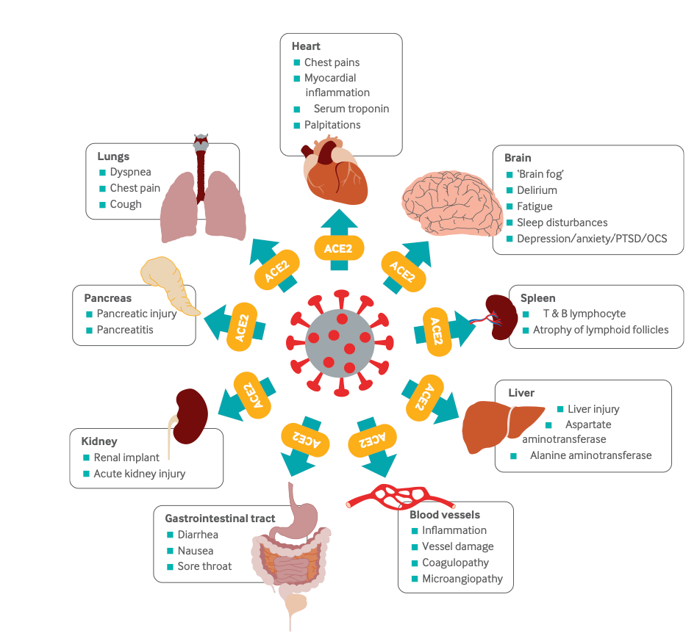
The symptoms

Slide 7
Symptoms Cluster
Fever
Headache
Symptoms may be persistent or fluctuant
Brain Fog
Fatigue
Breathlessness
Anxiety and Low Mood
Chest and body pain
Multi-Symptoms
Palpitations

Slide 8
Four basic syndromes
Post Intensive Care Syndrome,
Ongoing damage to the lungs and heart,
Post-viral fatigue,
  Very much aligned with Myalgic Encephalomyelitis / Chronic Fatigue Syndrome (ME/CFS), and
Continued COVID-19 syndromes

Slide 9
Underlying causes
Everything is theoretical…
Details are based on what is known about the virus and other similar diseases (specifically CFS/ME)

Slide 10
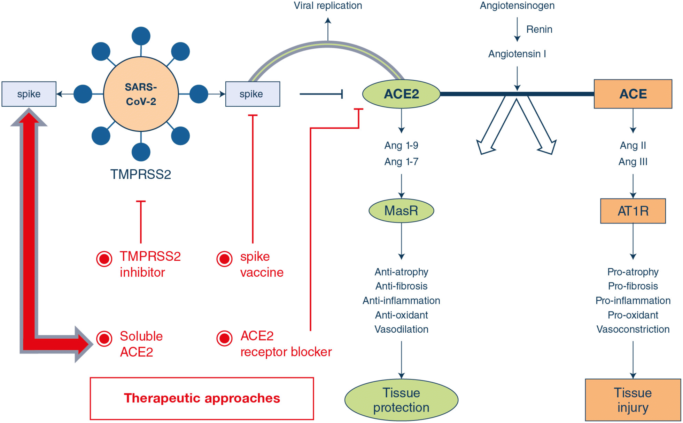
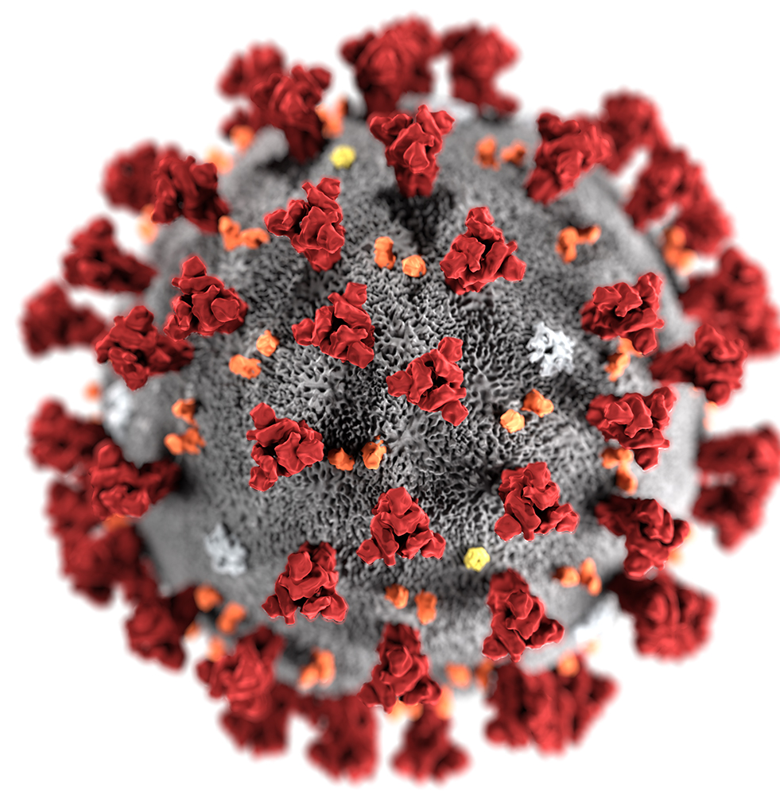
Mechanism of COVID Action

Slide 11
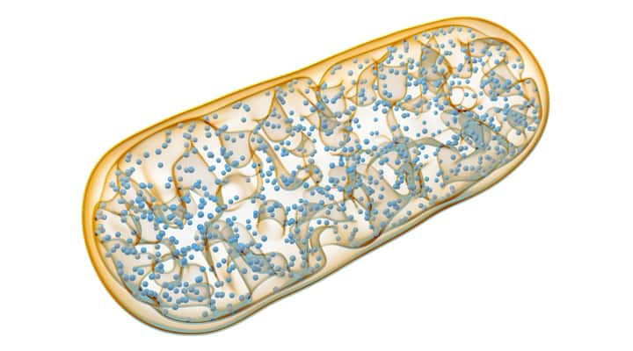
Mechanism of COVID Action

Slide 12
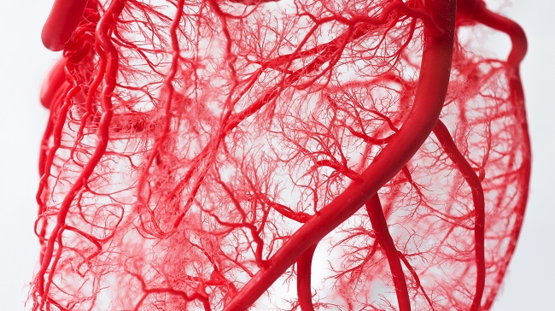
Mechanism of COVID Action

Slide 13
Mechanism of COVID Action

Slide 14
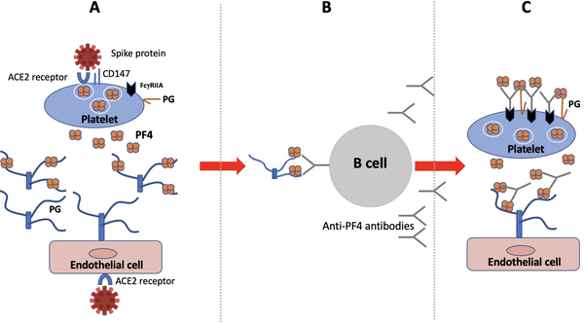
COVID and VITT
Goldman M, Hermans C (2021) Thrombotic thrombocytopenia associated with COVID-19 infection or vaccination: Possible paths to platelet factor 4 autoimmunity. PLOS Medicine 18(5): e1003648. https://doi.org/10.1371/journal.pmed.1003648 https://journals.plos.org/plosmedicine/article?id=10.1371/journal.pmed.1003648
Notes:
(A) SARS-CoV-2 induces the release of PF4 by activated platelets and of polyanionic PG by endothelial cells (e.g., syndecan and endocan). (B) Complexes of PF4 and PG expose PF4 immunogenic epitopes, which activate extrafollicular B lymphocytes secreting PF4 autoantibodies. (C) PF4 autoantibodies bind complexes of PF4 and PG on platelets and endothelial cells and stimulate their procoagulant activities. Cross-linking of FcγRIIA receptors also promote apoptosis and clearance of antibody-decorated platelets. COVID-19, Coronavirus Disease 2019; PF4, platelet factor 4; PG, proteoglycan; SARS-CoV-2, Severe Acute Respiratory Syndrome Coronavirus 2.

Slide 15
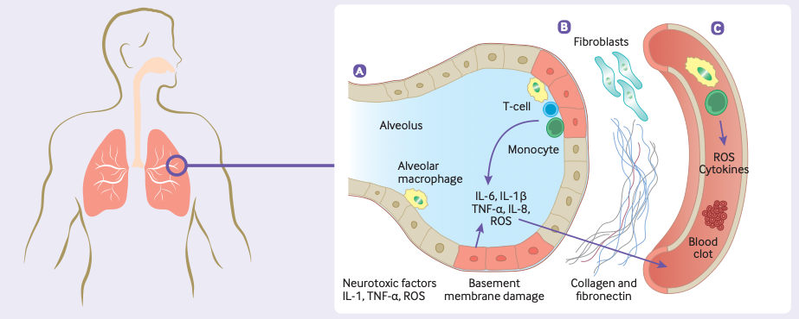
Pulmonary pathology
Notes:
(1) In the alveoli of the lungs: (A) Chronic inflammation results in the sustained production of pro-inflammatory cytokines and reactive oxygen species (ROS) which are released into the surrounding tissue and bloodstream. (B) Endothelial damage triggers the activation of fibroblasts, which deposit collagen and fibronectin resulting in fibrotic changes. (C) Endothelial injury, complement activation, platelet activation, and platelet-leukocyte interactions, release of pro-inflammatory cytokines, disruption of normal coagulant pathways, and hypoxia may result
in the development of a prolonged hyperinflammatory and hypercoagulable state, increasing the risk of thrombosis.

Slide 16
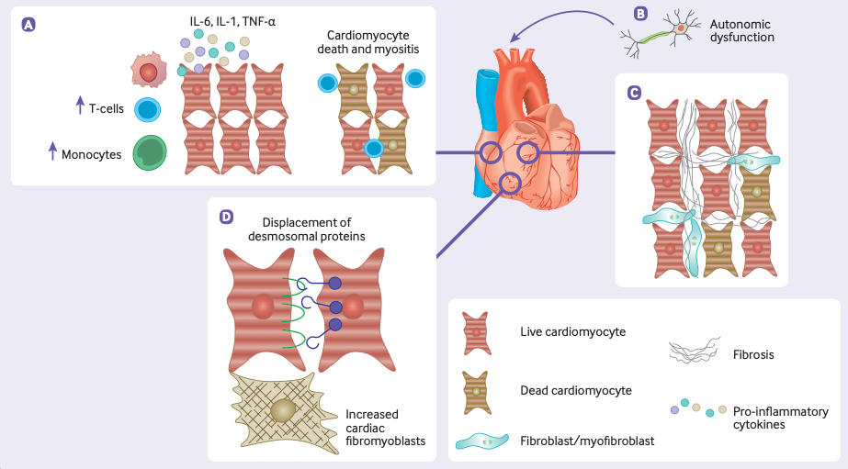
Cardiac pathology
Notes:
(2) In the heart: (A) chronic inflammation
of cardiomyocytes can result in myositis and cause cardiomyocytes death. (B) Dysfunction of the afferent autonomic nervous system can cause complications
such as postural orthostatic tachycardia syndrome. (C) Prolonged inflammation and cellular damage prompts fibroblasts to secrete extracellular matrix molecules and collagen, resulting in fibrosis. (D) Fibrotic changes are accompanied by an increase in cardiac fibromyoblasts, while damage to desmosomal proteins results in
reduced cell-to-cell adhesion.

Slide 17
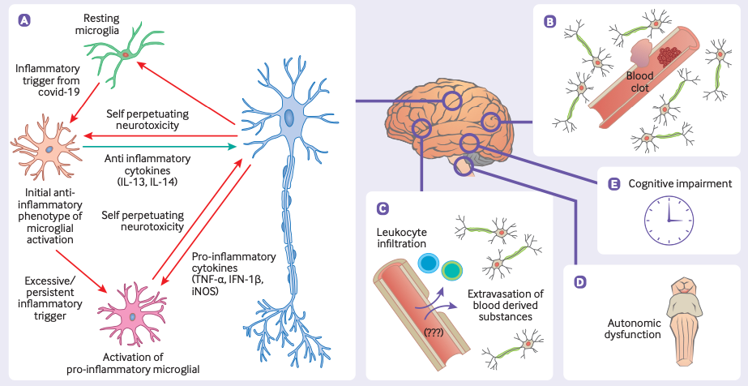
Neurological pathology
Notes:
(3) In the central nervous system: (A) The long term immune response activates glial cells which chronically damage neurons. (B) Hyperinflammatory and hypercoagulable states lead to an increased risk of thrombotic events. (C) Blood-brain barrier damage and dysregulation results in pathological permeability, allowing blood derived substances and leukocytes to infiltrate the brain parenchyma. (D) Chronic inflammation in the brainstem may cause autonomic dysfunction. (E) The effects of long covid in the brain can lead to cognitive impairment.

Slide 18
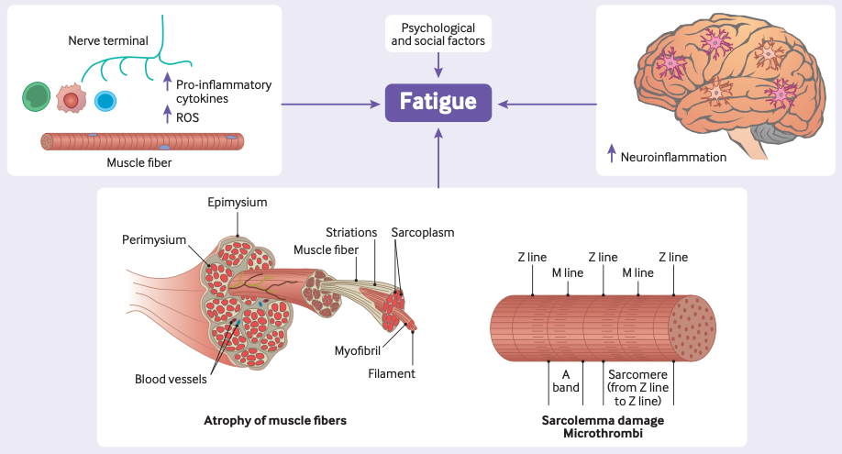
Fatigue
Notes:
(4) Possible mechanisms causing post-covid-19 fatigue. A range of central, peripheral, and psychological factors may cause chronic fatigue in long covid. Chronic inflammation in the brain, as well as at the neuromuscular junctions, may result
in long term fatigue. In skeletal muscle, sarcolemma damage and fiber atrophy and damage may play a role in fatigue, as might a number of psychological and social factors

Slide 19
Investigating Potential treatments
Very little is known
~£50m has been invested in the UK into research.
$1.4Bn in the US
Very little to report yet though
Although headline grabbing, this is not as impressive as it sounds…

Slide 20
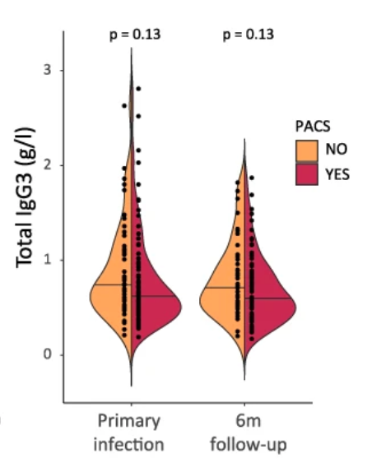
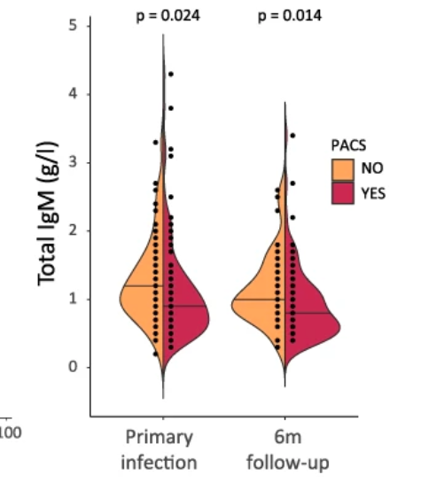
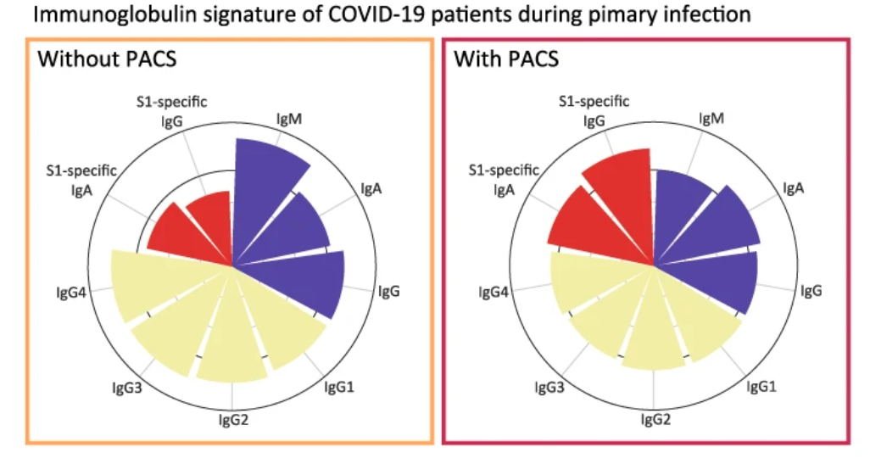
Immunological signatures of long COVID

Slide 21
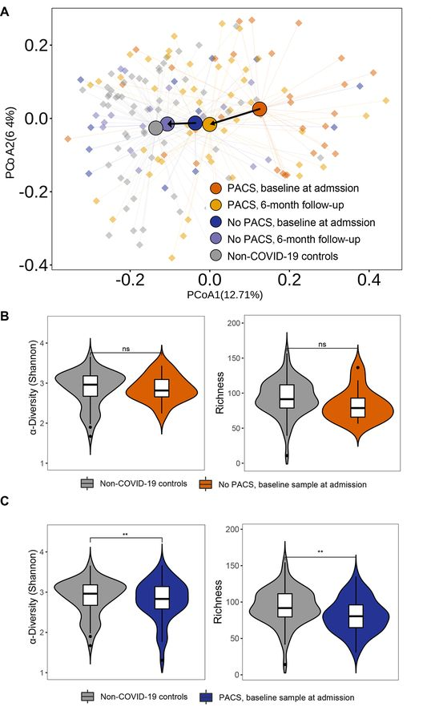
Changes in gut microbiome in those with long COVID
Notes:
Compositional differences in gut microbiota of baseline and follow-up samples at different time points after virus clearance. (A) Principal coordinates analysis (PCoA) of gut microbiota composition of patients with COVID-19 with or without post-acute COVID-19 syndrome (PACS) before and after negative reverse transcriptase-quantitative polymerase chain reaction for SARS-CoV-2 compared with non-COVID-19 subjects. (B) Diversity and richness analysis (as measured in Simpson diversity and Chao1 richness index, respectively) of gut microbiota in patients with COVID-19 at baseline compared with non-COVID-19 subjects. (C) Diversity and richness analysis of gut microbiota in patients with COVID-19 at 6 months' follow-up compared with non-COVID-19 subjects. (D) Change of gut microbial composition from baseline to 6 months' follow-up after virus clearance in patients with COVID-19 with or without PACS. (E) Linear discriminant analysis effect size in gut microbiome of recovered patients with PACS at baseline.

Slide 22
Could residual virus represent a therapeutic target?
Post vaccination
Pre vaccination
Number of patients reporting each severity of symptom before and after vaccination
Symptom

Slide 23
Differential benefit based on vaccine technology
Symptom | AZ/Oxford | Pfizer | p vs AZ | Moderna | p vs AZ | p vs Pfizer
Fatigue | 13.7 (9.7-17.8) | 17.8 (13.2-22.4) | 0.4 | 26.5 (16.9-36.1) | 0.009 | 0.08
Brain Fog | 22.2 (17.4-27.0) | 21.7 (16.1-27.2) | 0.9 | 31.7 (20.6-42.9) | 0.01 | 0.02
Myalgia | 11.5 (6.1-16.8) | 16.8 (10.4-23.1) | 0.3 | 30.7 (18.3-43.0) | 0.006 | 0.04
Shortness of Breath | 23.2 (18.1-28.3) | 24.5 (18.6-30.3) | 0.5 | 33.7 (21.6-45.8) | 0.07 | 0.2
Insomnia | 23.6 (17.2-30.1) | 28.5 (21.3-35.7) | 0.8 | 30.2 (16.2-44.2) | 0.1 | 0.2
Chest Pain/Palpitations | 25.6 (20.0-31.1) | 26.1 (19.8-32.3) | 0.98 | 34.8 (22.1-47.5) | 0.2 | 0.2
GI symptoms | 24.7 (18.5-31.0) | 24.6 (17.4-31.8) | 0.98 | 41.7 (27.8-55.6) | 0.002 | <0.001
Anosmia | 33.5 (26.7-40.2) | 31.5 (24.1-38.9) | 0.7 | 46.3 (26.1-46.3) | 0.4 | 0.2
Autonomic dysfunction | 23.9 (16.2-31.7) | 28.9 (13.6-44.3) | 0.01 | 33.7 (25.4-41.9) | 0.004 | 0.1
POTS | 23.0 (15.3-30.7) | 25.4 (17.0-33.7) | 0.7 | 27.7 (11.7-43.7) | 0.1 | 0.2
Persistent Cough | 24.1 (16.4-31.8) | 26.1 (17.1-35.1) | 0.5 | 32.4 (15.5-49.3) | 0.3 | 0.2
Fever | 1.7 (-10.5-13.9) | 22.4 (8.6-36.3) | 0.4 | 36.2 (10.1-62.2) | 0.1 | 0.1
Rash (inc Covid toes) | 29.7 (12.7-37.6) | 32.4 (23.6-41.1) | 0.7 | 33.9 (17.0-50.9) | 0.6 | 0.6
Vascular complications | 25.3 (15.7-34.) | 29.8 (19.1-40.4) | 0.7 | 31.4 (10.8-52.0) | 0.8 | 0.6

Slide 24


Genetics studies

Slide 25
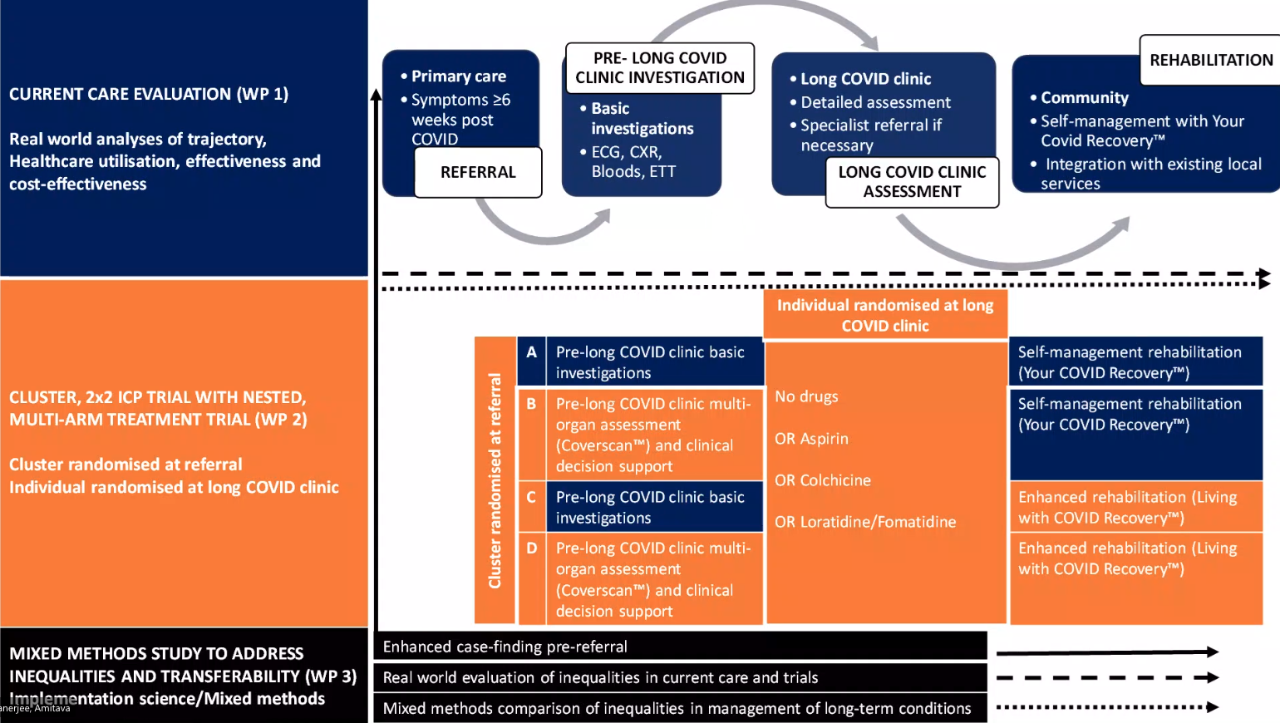
The Future

Slide 26
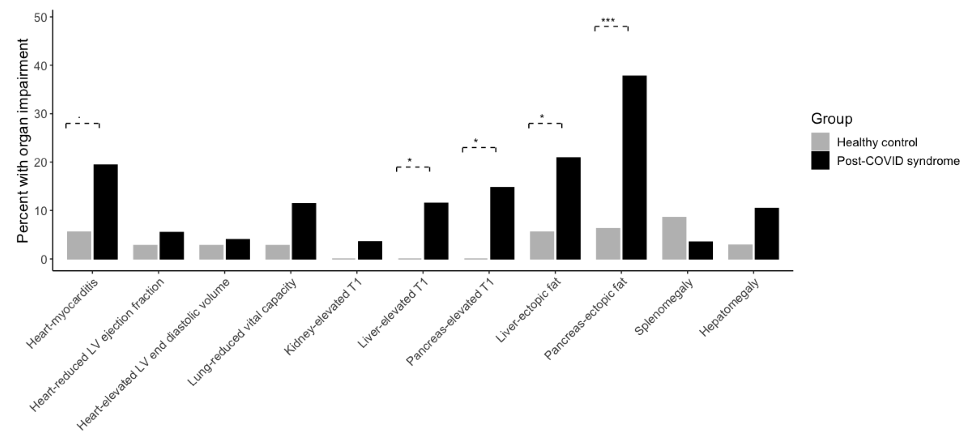
Coverscan – preliminary findings

Slide 27
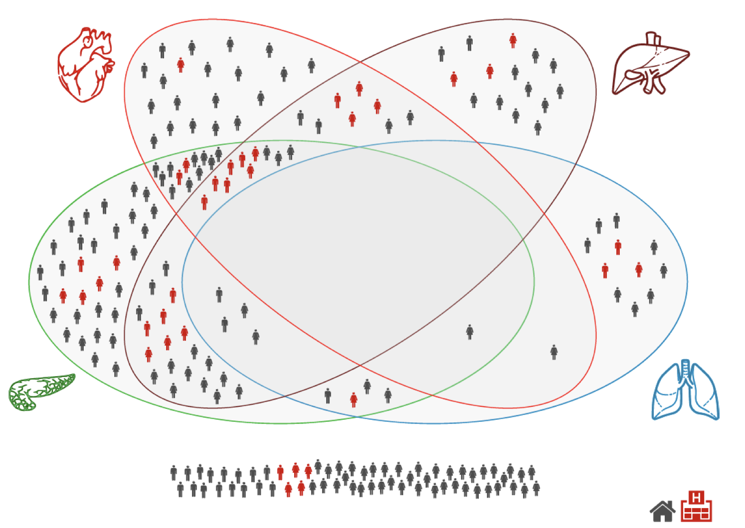
Coverscan – preliminary findings

Slide 28
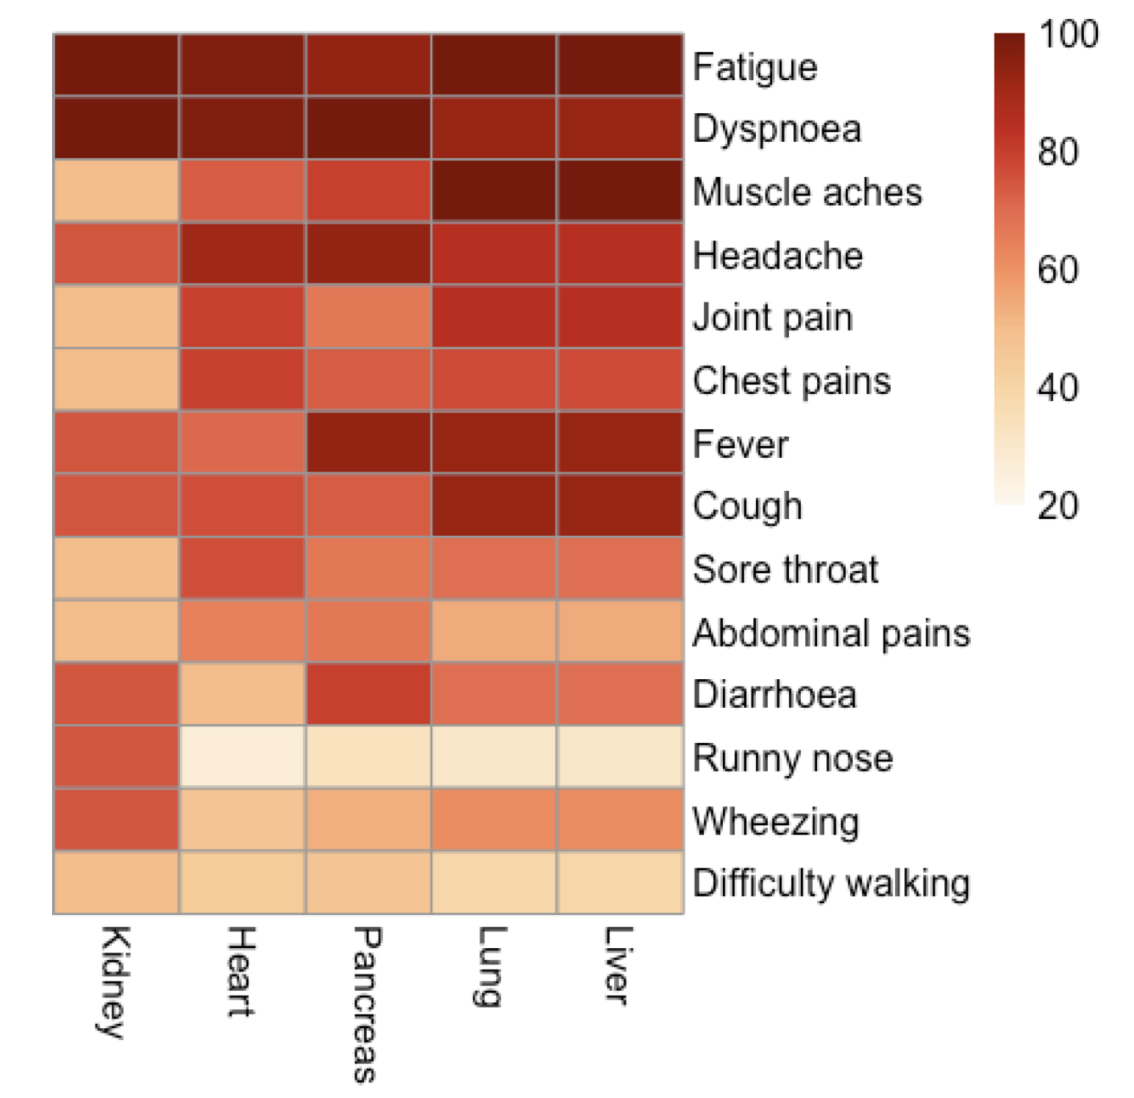
Coverscan – preliminary findings

Slide 29
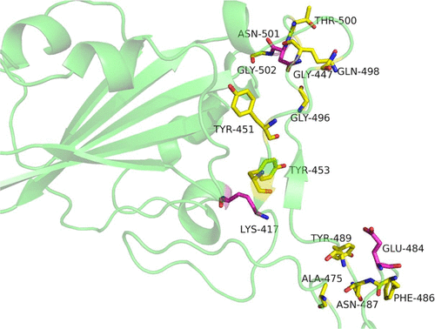
Alternative targeted therapies
Cannabinoids Block Cellular Entry of SARS-CoV-2 and the Emerging Variants
J. Nat. Prod. 2022, 85, 1, 176–184
Notes:
Four proteins are known to be altered by COVID. The first protein is called ACE2. ACE2 is actually the principal target of the COVID virus. The virus finds the ACE2 protein floating on the surface of a cell and binds to it in order to gain entry into the cell. Once inside, the virus starts replicating itself using the cell’s own genetic machinery.
The second protein affected by COVID is the cytokine Interleukin-6 (IL-6). IL-6 is a powerful pro-inflammatory cytokine that is essential during the initial inflammatory response by the body following invasion by the virus. A third protein, called transmembrane serine protease (TSP), can actually activate COVID; its level is elevated in long-haulers. The fourth protein affected in COVID long-haulers is called NRP1. NRP1 plays an important role in COVID infection in humans by assisting the virus’ actions. Blocking the NRP1 interaction with the virus reduces its infectivity.
A recent investigation targeted the proteins ACE2, IL-6, TSP, and NRP1 that are known to be damaged or upregulated by COVID. Two different molecules found in the cannabis plant, cannabidiol (CBD) and cannabivarin (CVN), were investigated for potential use in long-hauler COVID patients.
Using a series of sophisticated molecular docking and simulation studies, scientists discovered that CBD and CVN can effectively bind to these proteins and downregulate them. Taken together, these studies suggest that some components of the cannabis plant might be beneficial as a post-covid treatment strategy. Obviously, much more research is required in order to prove the effectiveness of these cannabinoids.

Slide 30
Potential use of immunoglobulins
Ronapreve contains two mAbs: casirivimab and imdevimab
Highly effective against Original, Alpha and Delta variants
  Ineffective against Omicron
May have therapeutic possibilities for long COVID
Notes:
One of the mAbs is derived from a COVID-fighting immune cell taken from a human survivor of the disease. The other was produced in a mouse genetically modified to have a human immune system. The advantage of combining the two is that they target two different parts of the spike protein, many of which protrude from the coronavirus – these are what it uses to bind with ACE2. Using both reduces the chance of the virus escaping from the immune system.
A main study (COV-2067) involving patients with COVID-19 who did not require oxygen and were at increased risk of their illness becoming severe showed that Ronapreve at the authorised dose led to fewer hospitalisations or deaths when compared with placebo (dummy treatment). Overall, 0.9% of patients treated with Ronapreve (11 out of 1,192 patients) were hospitalised or died within 29 days of treatment compared with 3.4% of patients on placebo (40 out of 1,193 patients).
Prevention of COVID-19
A main study (COV-2069) looked at the benefits of Ronapreve for prevention of COVID-19 in people who had close contact with an infected household member.
Ronapreve was found to be effective at preventing people from getting infected and developing symptoms after contact: amongst people who tested negative for SARS-CoV-2 following contact, fewer people given Ronapreve developed symptoms within 29 days of their test results compared with people given placebo (1.5% (11 out of 753) for Ronapreve compared with 7.8% (59 out of 752 people) for placebo).
Ronapreve was also found to be effective at preventing symptoms in infected people. Amongst the people who tested positive for SARS-CoV-2 after contact, 29% (29 out of 100) of people who received Ronapreve developed symptoms compared with 42.3% (44 out of 104 people) of people who received a placebo.

Slide 31
Immunoglobulin based treatment
Aptamer BC 007 is an immunomodulator
Modifies metabolic dysregulation in non-ischaemic cardiomyopathy
  (G protein coupled receptors, including β1 Aab)
In one patient with cardiomyopathy and Long Covid they reported improvement of long-standing symptoms within an hour
Analyses now underway to explore potential interaction
There is an overlap between antibodies against SARS-CoV-2 and _{f}GPCR-AABs

Slide 32
Other trials underway
Respiratory symptoms
  hyperbaric oxygen(NCT04842448),
  montelukast(NCT04695704), and
  deupirfenidone (NCT04652518)
Fatigue
  8 week exercise program in patients (NCT04841759).
  Vitamin C supplementation ( LOVIT-COVID - NCT04401150) (hospitalized patients only).
  nicotinamide riboside, a dietary supplement, (NCT04809974, NCT04604704)
  probiotic supplement (NCT04813718).
Non-specific treatments
  Leronlimab (monoclonal antibody against CCL-5 (NCT04343651, NCT04347239, NCT04678830).
  Tocilizumab, (monoclonal against interleukin-6 receptors) (NCT04330638).
  Melatonin (NCT04795557).
Notes:
nicotinamide riboside, a dietary supplement, (NCT04809974, NCT04604704) with the expectation that the molecule reduces cognitive symptoms and fatigue by modulating the pro-inflammatory response.212
probiotic supplement to normalize the composition of the gut microbiome and reduce inflammation in long covid (NCT04813718).
The anti-oxidative and anti-inflammatory function of melatonin may also be useful in treating long covid

Slide 33
Other trials underway
Fatigue
  nicotinamide riboside, a dietary supplement, (NCT04809974, NCT04604704)
  probiotic supplement (NCT04813718).
Non-specific treatments
  Leronlimab (monoclonal antibody against CCL-5 (NCT04343651, NCT04347239, NCT04678830).
  Tocilizumab, (monoclonal against interleukin-6 receptors) (NCT04330638).
  Melatonin (NCT04795557).
Notes:
nicotinamide riboside, a dietary supplement, (NCT04809974, NCT04604704) with the expectation that the molecule reduces cognitive symptoms and fatigue by modulating the pro-inflammatory response.212
probiotic supplement to normalize the composition of the gut microbiome and reduce inflammation in long covid (NCT04813718).
The anti-oxidative and anti-inflammatory function of melatonin may also be useful in treating long covid
Leronlimab (PRO) 140 is a humanized IgG4, monoclonal antibody (mAb) to the C-C chemokine receptor type 5 (CCR5)

Slide 34
Pragmatic treatment options

Slide 35
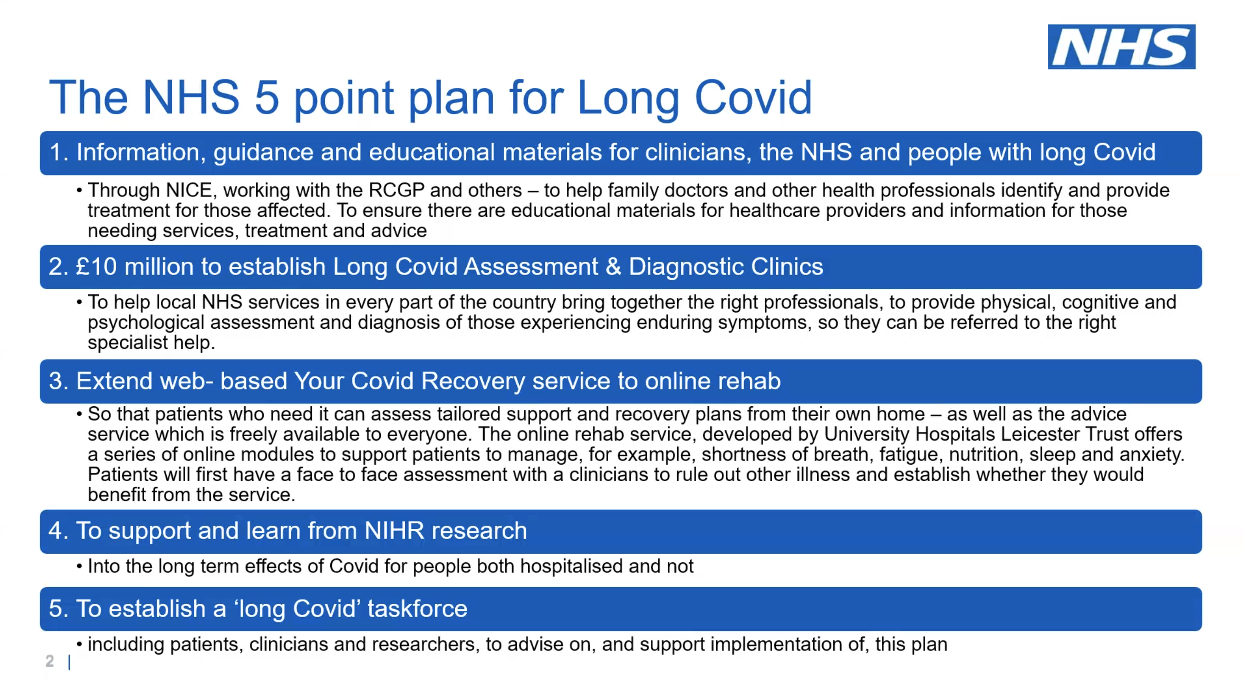

Slide 36
Providing a long COVID assessment service
LC is a multisystem disease and requires a multi-disciplinary approach
Expertise in Pulmonary, Cardiac, Neuro psychological rehab is required
1 central communication point

Slide 37
Practical - Diagnostic workup
Full Blood Count
Renal function test
Liver function test
Troponins
C-Reactive Protein
Creatinine Kinase
D-dimer
NT-BNP
HbA₁c
TSH
TTG
Ferritin

Slide 38
Further investigations
Chest X-ray
Urinalysis
12 Lead ECG
Holter Monitor
Pulse Oximetry
Respiratory Function tests
Cardiac MRI
Psychological evaluation
Other tests as indicated
38

Slide 39
Interventions
Breathing techniques
Sit in a supported position
Breathe in and out slowly,
Aim for an inspiration to expiration ratio of 1:2.
Use frequently throughout the day, in 5-10 minute bursts
Notes:
About 80% of the work of breathing is done by the diaphragm. After illness or general deconditioning, the breathing pattern may be altered, with reduced diaphragmatic movement and greater use of neck and shoulder accessory muscles. This results in shallow breathing, increasing fatigue and breathlessness, and higher energy expenditure. The “breathing control” technique is aimed at normalising breathing patterns and increasing the efficiency of the respiratory muscles (including the diaphragm) resulting in less energy expenditure, less airway irritation, reduced fatigue, and improvement in breathlessness.
Other breathing techniques—such as diaphragmatic breathing, slow deep breathing, pursed lip breathing, yoga techniques, Buteyko—are used in strategies to manage patients’ breathing patterns and breathlessness but require specialist advice to identify which technique best suits each patient.

Slide 40
Exercise
One of the most controversial topics
GET works for some
GET makes some worse.
Should not be recommended…

Slide 41
Summary
Management of covid-19 after the first three weeks is currently based on limited evidence
Approximately 10-14% of people experience prolonged illness after covid-19
Many patients recover spontaneously (if slowly) with holistic support, rest, symptomatic treatment, and gradual increase in activity
Indications for specialist assessment include clinical concern along with respiratory, cardiac, or neurological symptoms that are new, persistent, or progressive

Slide 42
Thank you for your attention

