Slide 1
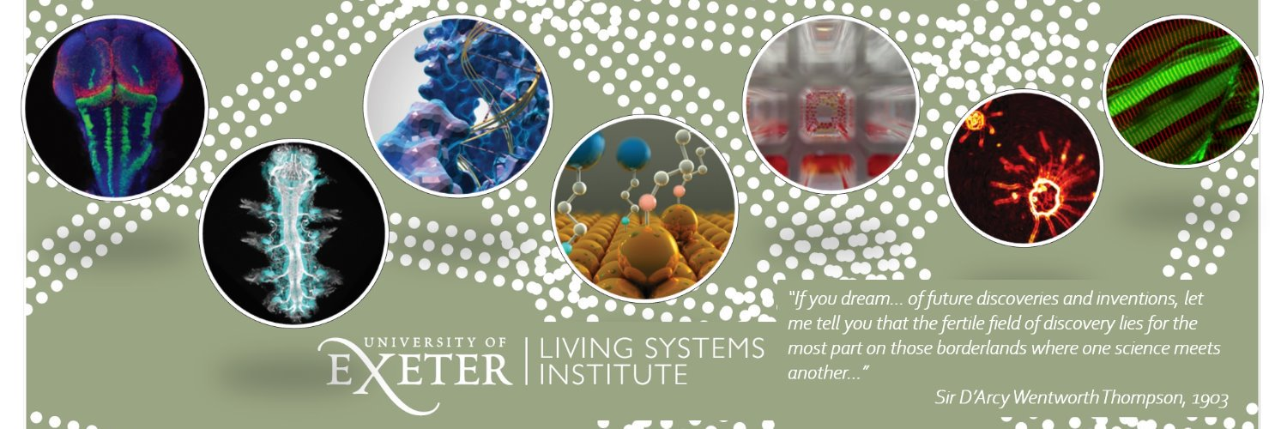
Studying early embryo development using human naïve pluripotent stem cells
Ge Guo
郭 歌
Clinic and Biomedical Science / Living Systems Institute
https://www.exeter.ac.uk/livingsystems

Slide 2
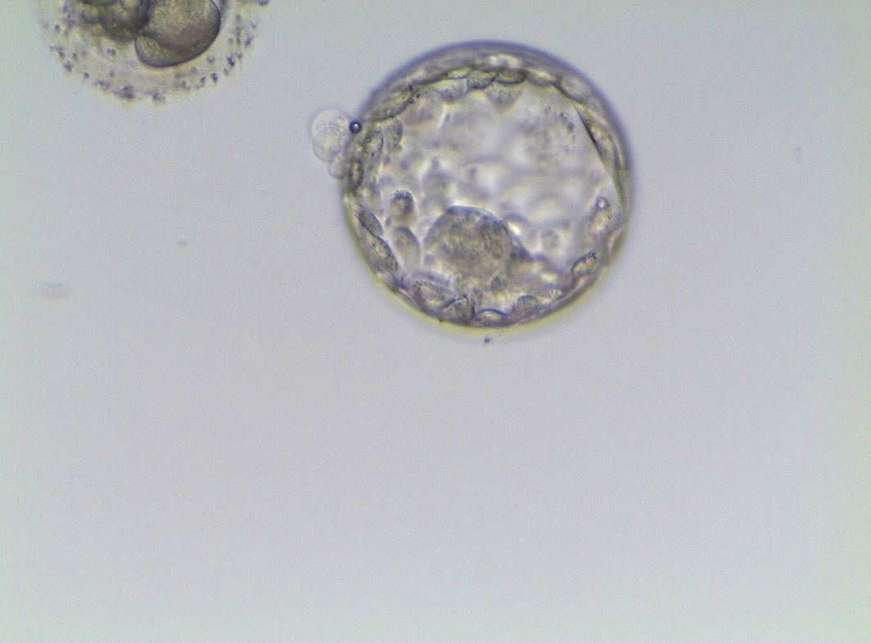
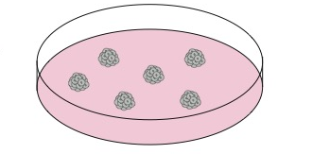
Reconstruction of human embryo
Natural embryo
Stem cell model
Naïve pluripotent stem cells

Slide 3


Pluripotent cells in the embryo
Mouse
Zygote
Morula
blastocyst
Egg cylinder
E0.5
E3.0
E3.5
E4.5
E5.5
implantation
Epiblast
Hypoblast ( PRE)
Trophoblast

Slide 4
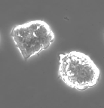
Paradigm of pluripotency: mouse embryonic stem cells (ES cells)
Self-renewal
Evans and Kaufman, 1981
Unlimited self-renewal
Differentiation to all cell types in the body

Slide 5
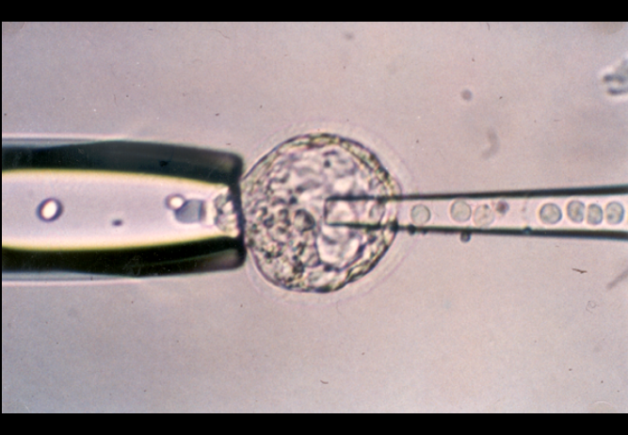
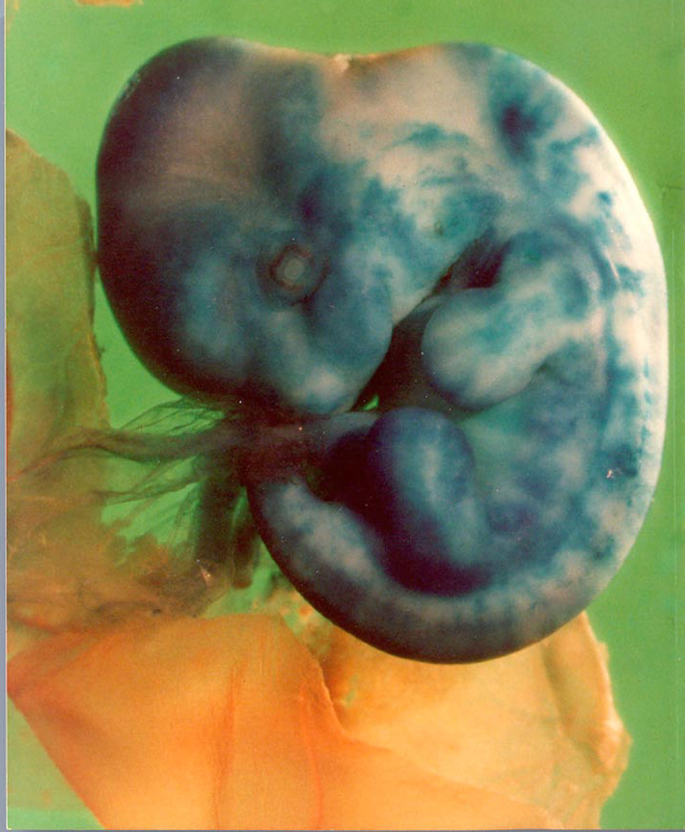
ES cells re-enter embryo development
Courtesy of Andras Nagy

Slide 6
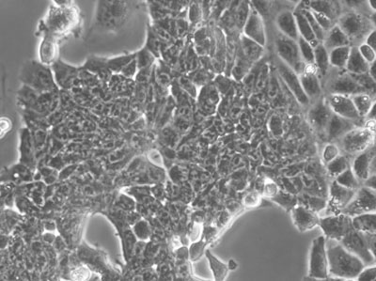
Two pluripotency state
Naive
Primed
E5.5
E4.5
Uterus
implantation
Blastocyst
Egg cylinder
Tesar 2007
Brons 2007

Slide 7
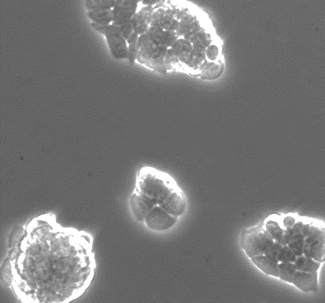
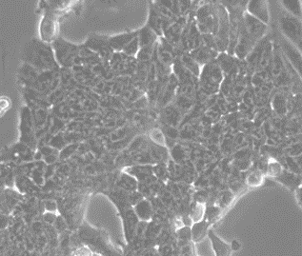
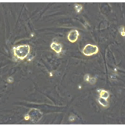
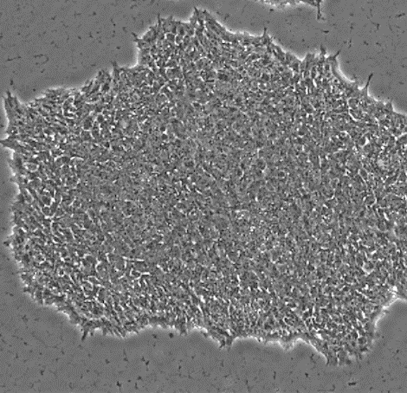

Conserved pluripotent state
Naive
Primed
Mouse
Thomson 1998
Takashima et al 2014
Theunissen et al 2014
Human ES cells

Slide 8
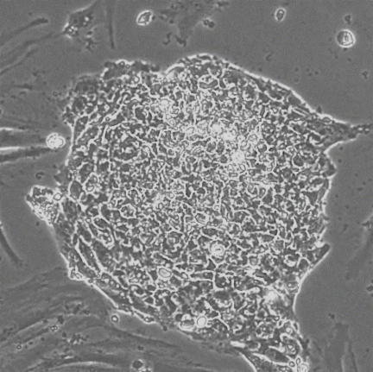
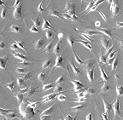
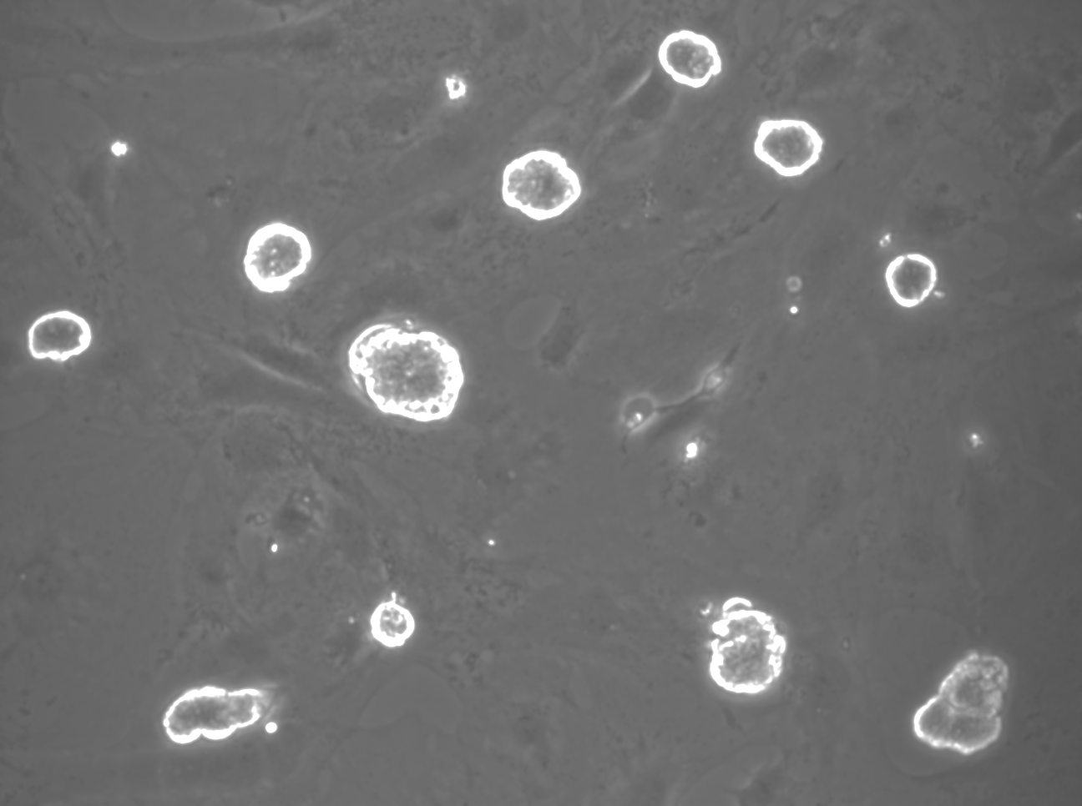
Human naïve pluripotent stem cells
Blastocyst
Primed PSC
Somatic cells
Derivation
(2016)
Resetting
Reprogramming
(2017)
(2019)
Naïve PSC
(PXGL)

Slide 9
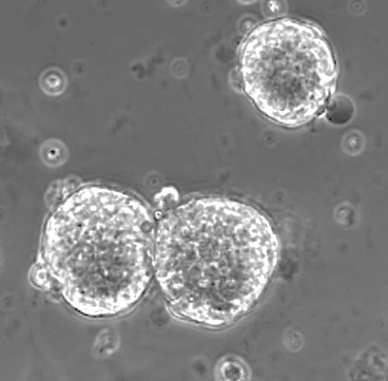
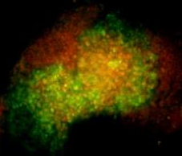
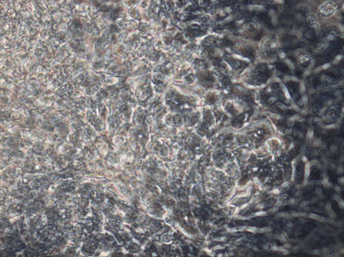
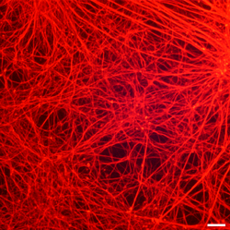
Human naïve PSC are Pluripotent
Formative transition
Endoderm
Mesoderm
Ectoderm

Slide 10
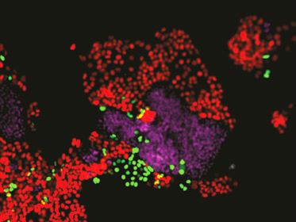
Human naïve PSCs make all cell types in the blastocyst
TE
Epiblast
Hypoblast
3 days differentiation in culture
Guo et al 2021

Slide 11
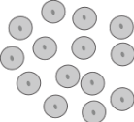
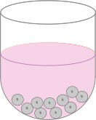
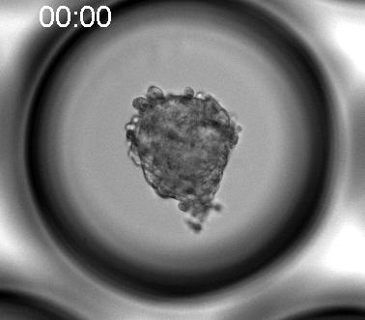
Construction of a human blastocyst model
Day 1-2
Day2-3
Day3-4
TE induction
Cavitation
Hypoblast formation
Day2-Day3
Yanagida et al 2021

Slide 12
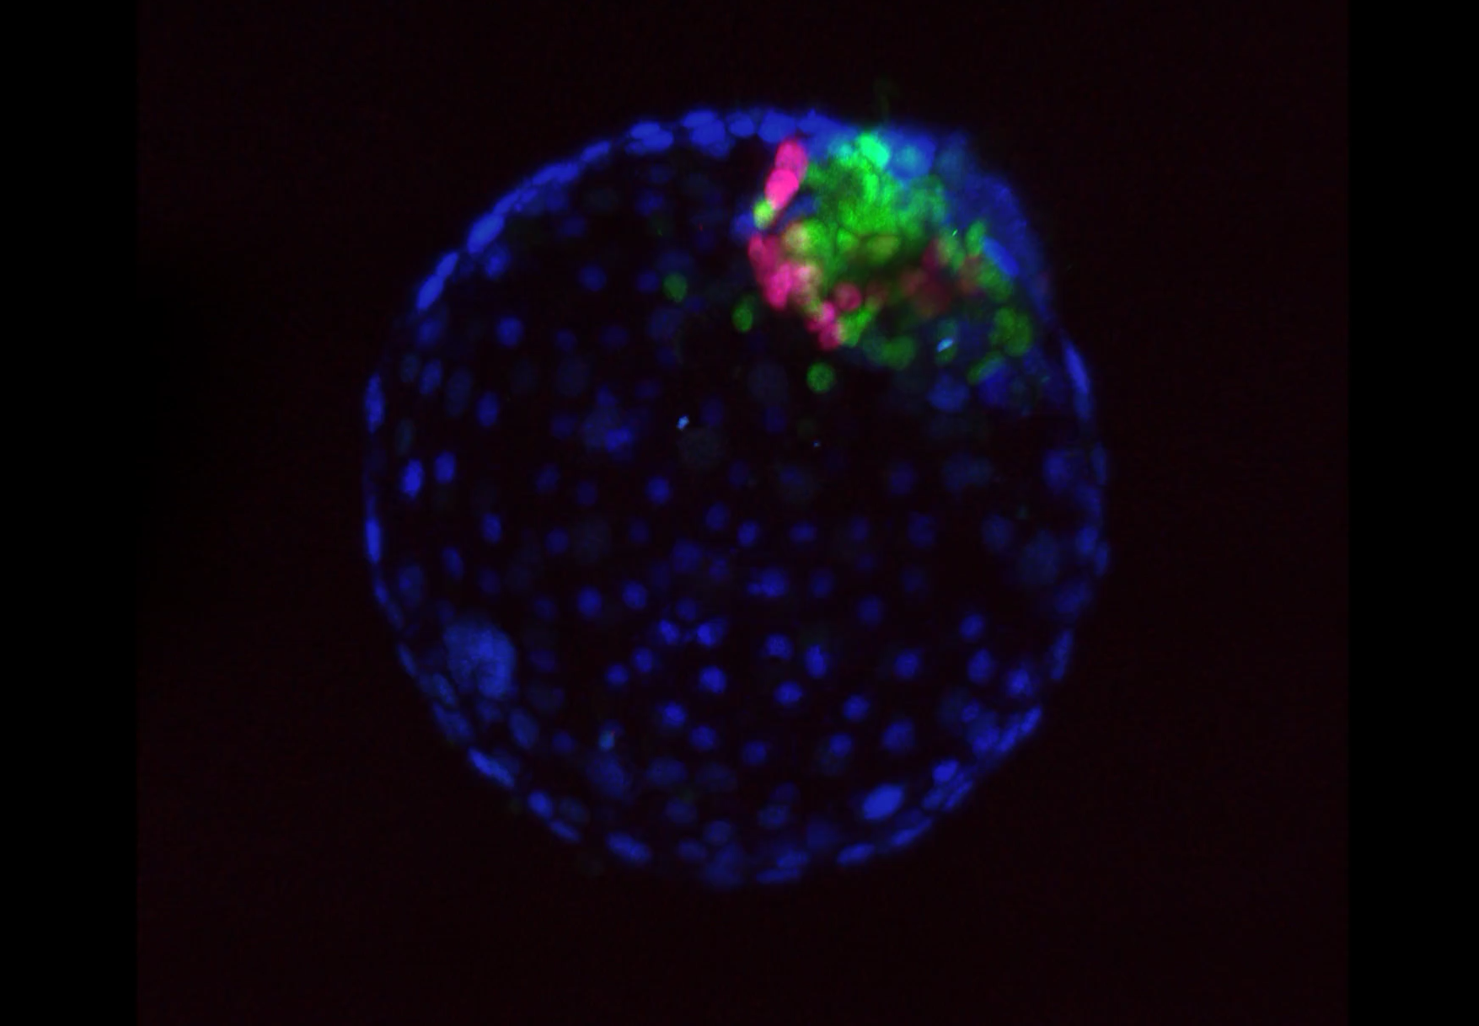
Localization of the three primary lineages

Slide 13
Global gene expression analysis shows lineage fidelity between our blastoids and human blastocysts
Nearly all cells have embryo lineage identity
Notes:
t-distributed stochastic neighbour embedding (tSNE)

Slide 14
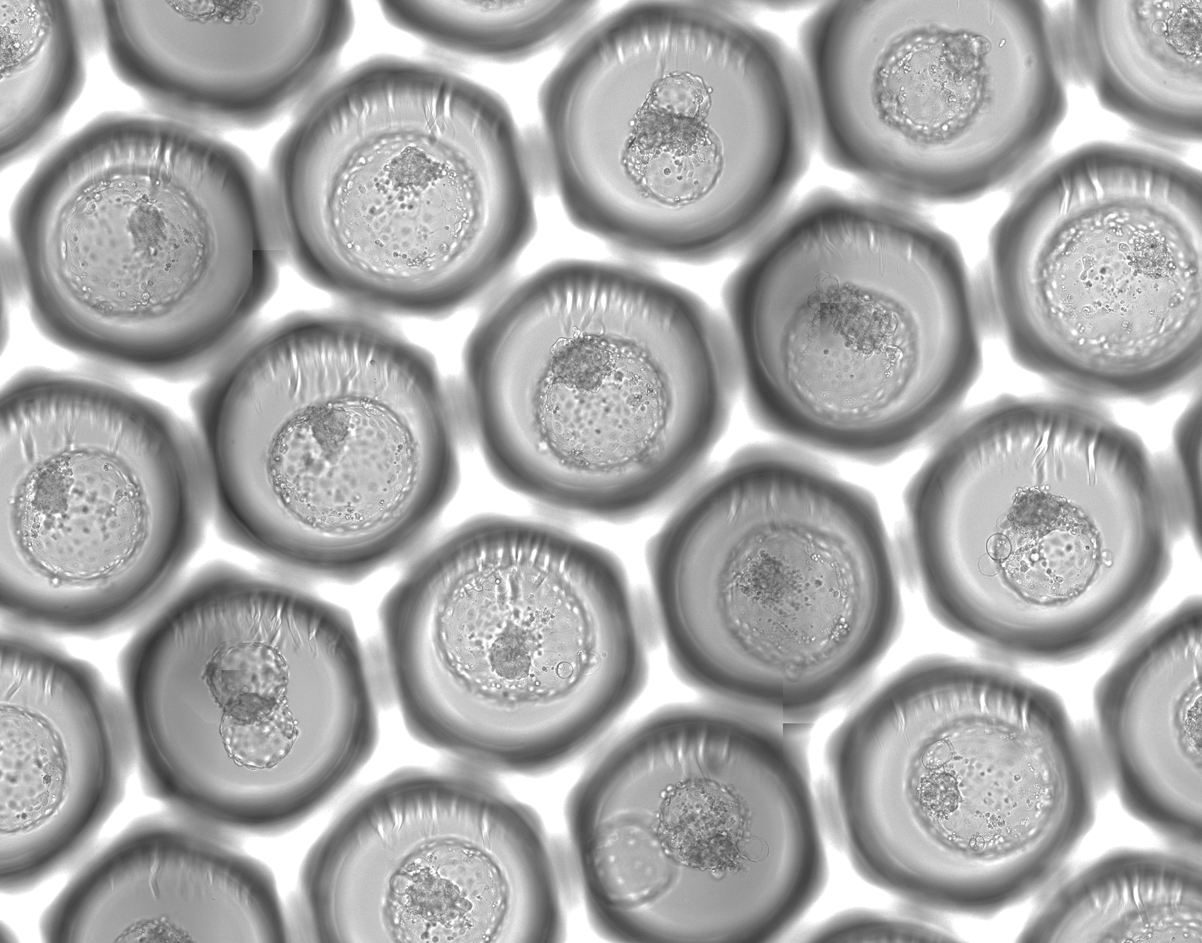
Blastoid generation is robust and scalable
By Dorian Luijkx
Arrayed Microwell

Slide 15
Model of peri-implantation of human embryo development
Model of peri-implantation development
yolk sac like cavity
Amniotic cavity
Amnio
DAPI
NANOG
GATA4
PODXL

Slide 16
Criteria for a reliable blastocyst model
Correct topological segregation of three lineages
High transcriptome fidelity with human embryo blastocyst lineages, with few or no unassigned cells
Capable of further development in extended culture

Slide 17
Opportunities provided by blastoid
Embryo
Embryo Models
Scarce material
Various quality
Limited manipulation
Unrestricted source
Standardised material
Ready genetic manipulation

Slide 18
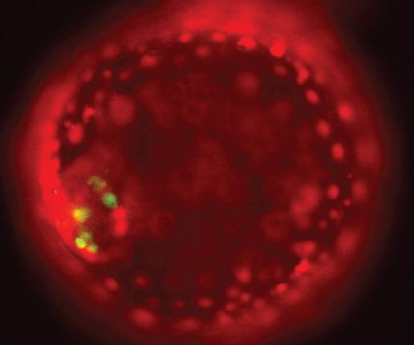
Live imaging with fluorescent reporters
Naïve cells carrying Knock-In fluorescent reporters
TE: GATA3_mKO2
Hypoblast: SOX17_GFP

Slide 19
Applications
Toxicity test and drug screening
Improvement of IVF clinic procedures
Implantation and placentation
Picture: modified from Wikimedia.org

Slide 20

Early embryo development
E0
E2
E3-4
E5
E6-7
uterus
implantation
Blastocyst
Coordinated events:
Cell division
Cell fate specification
Spatial organization

Slide 21
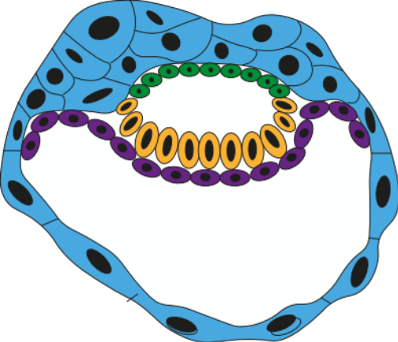
Synthetic Embryogenesis
Pre-implantation
Peri-implantation
Investigate and understand how a complex biological structure is formed and regulated at molecular, cellular and structural levels.
Integration of developmental and stem cell biology with
bioengineering, advanced imaging and biophysical modelling

Slide 22
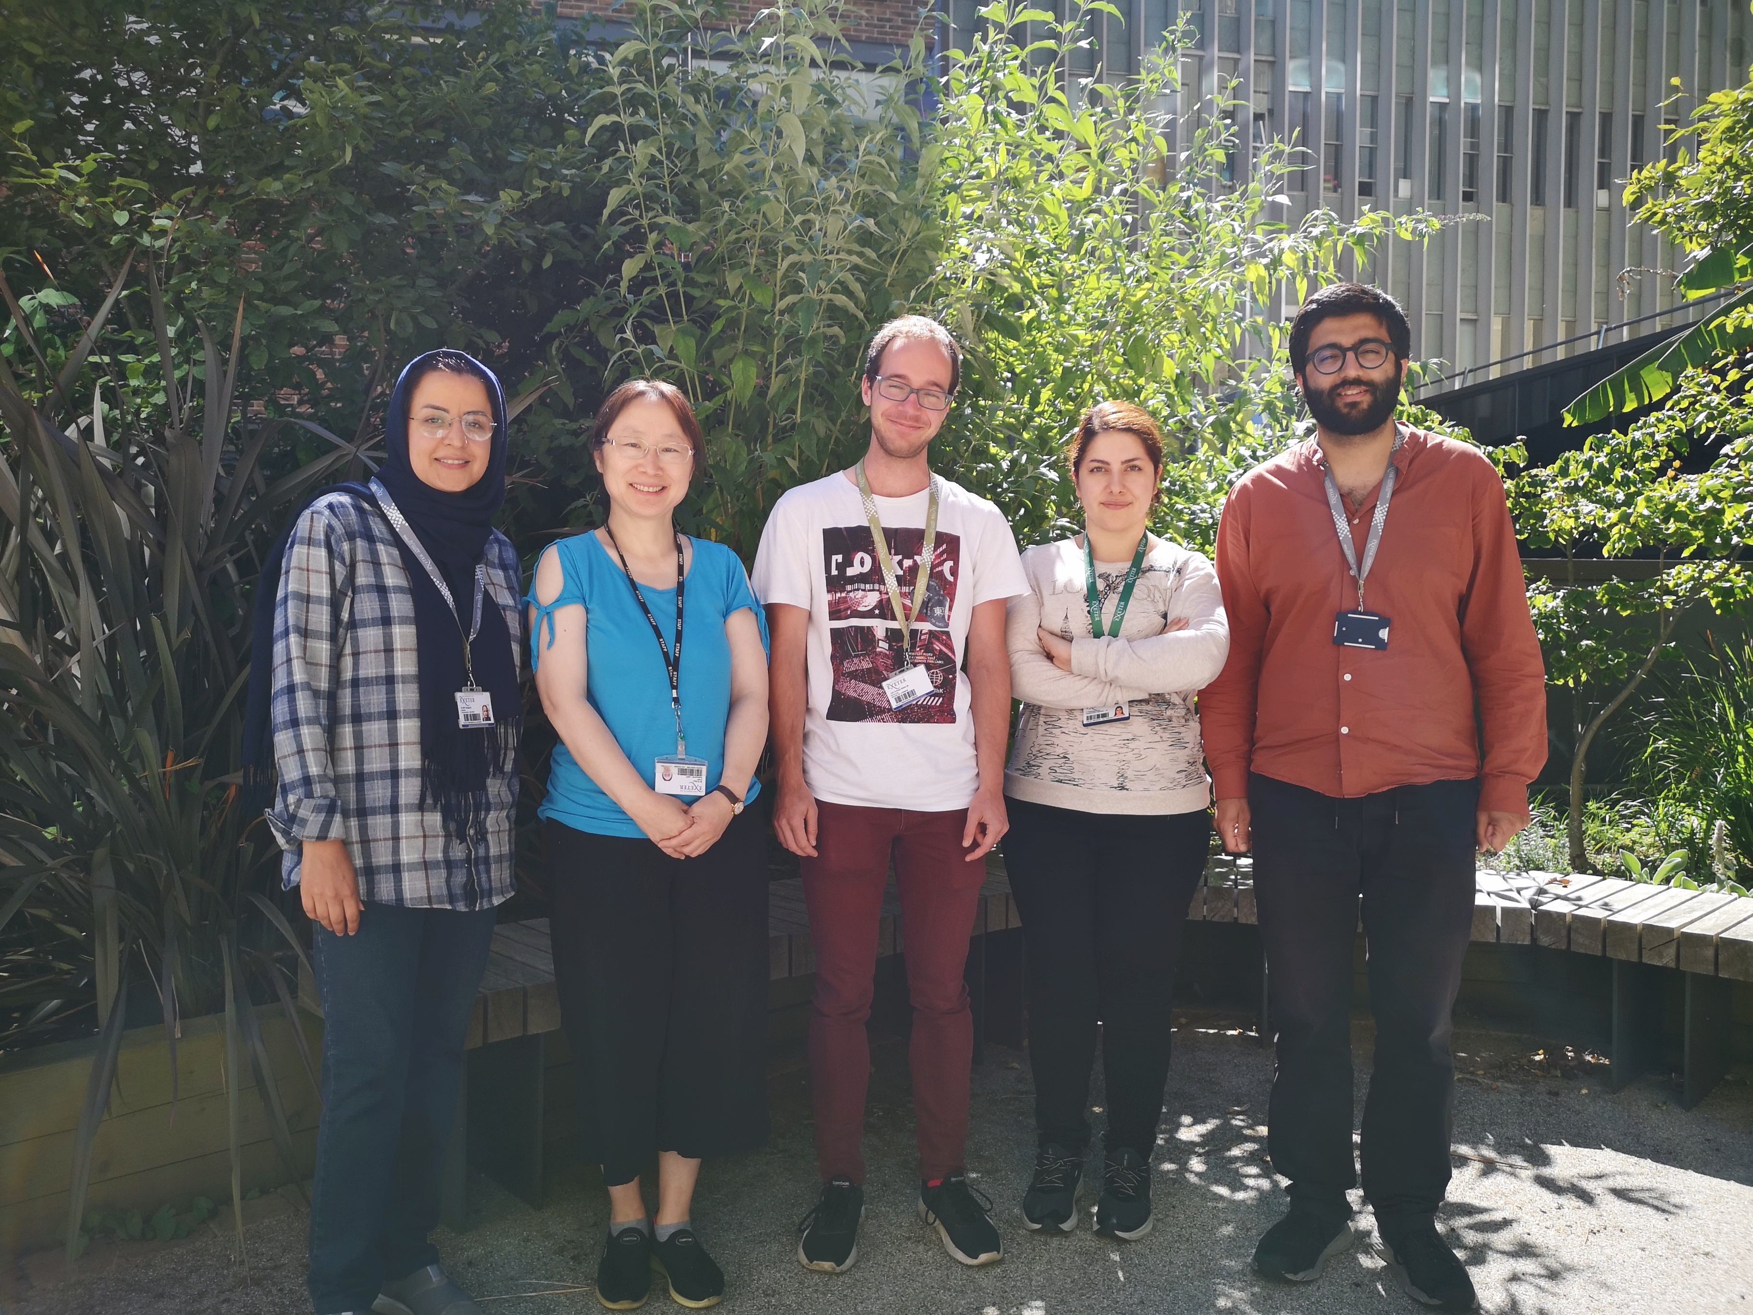

Team of synthetic embryogenesis
Bioimaging facility
Maastricht University
Dr Stefan Giselbrecht
Corin Liddle
Dorian Luijkx
https://www.exeter.ac.uk/livingsystems
Ge Guo, g.guo@exeter.ac.uk

