Slide 1



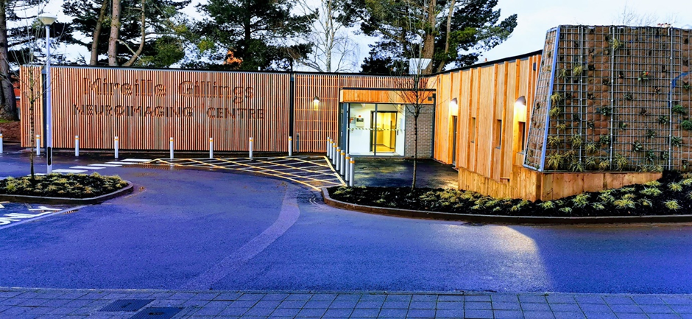
Imaging Research at the Mireille Gillings Neuroimaging Centre

Slide 2
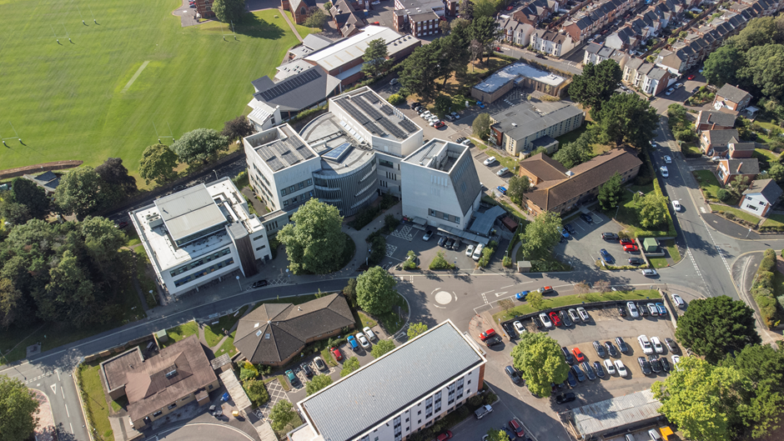
The Mireille Gillings Neuroimaging Centre (MGNC)
Notes:
We’re just across the car park!

Slide 3
The Mireille Gillings Neuroimaging Centre (MGNC)
Notes:
We’re just across the car park!

Slide 4

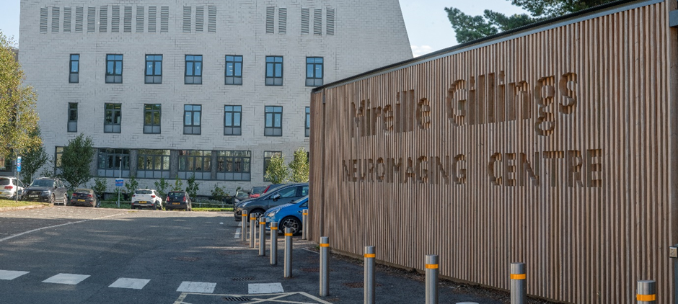
Notes:
We’re just across the car park!

Slide 5
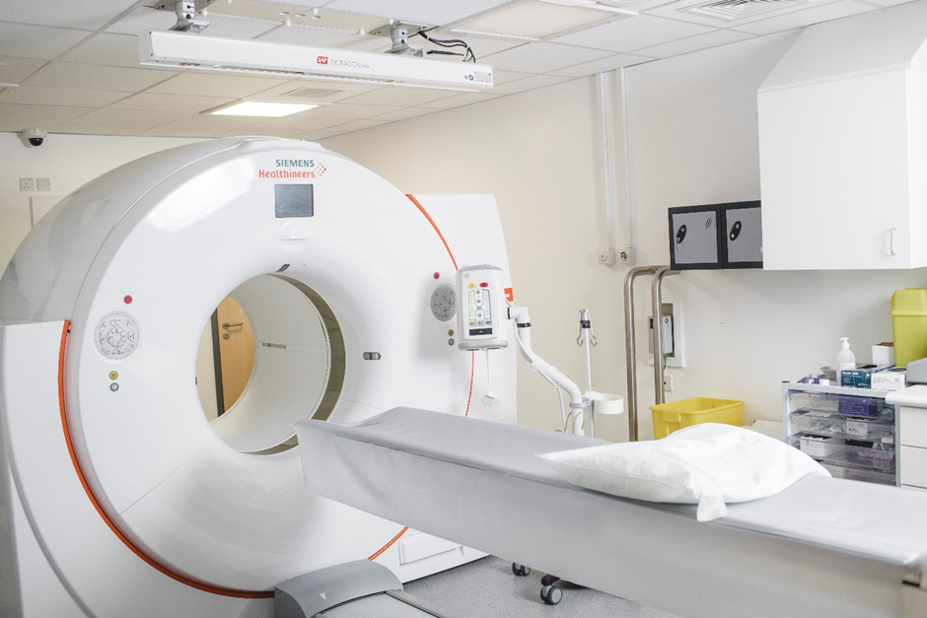
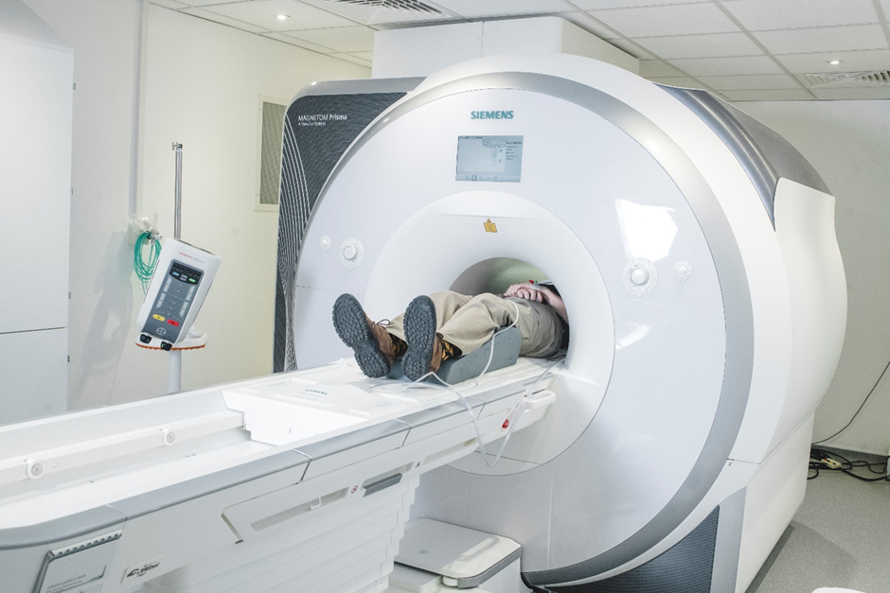
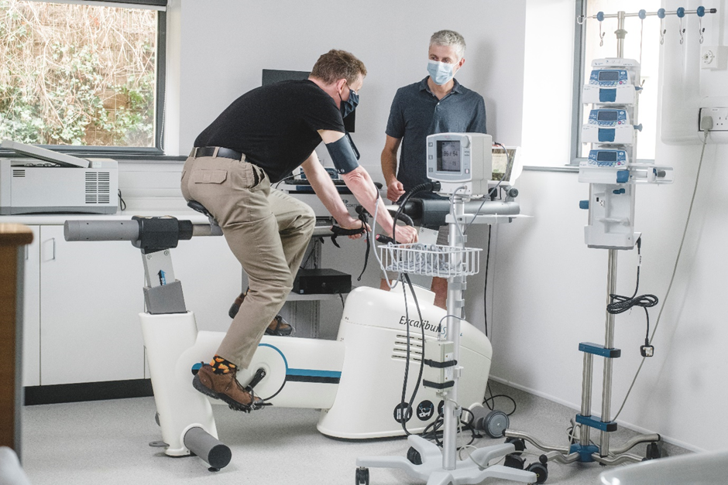
What we do
Provides state-of-the-art MRI and PET-CT scanning for research, clinical diagnosis and therapeutic purposes.
PET-CT
MRI
Clinical rooms

Slide 6



Who we are
Director
Professor Marios Politis
Imaging Lead
Dr Heather Wilson
MRI Lead
Dr Jon Fulford

Slide 7



Who we are
Clinical Applications Lead
Dr Edoardo De Natale
Facilities Manager
Dr Cameron Hird
Business Manager
Dr Lisa Cashmore

Slide 8
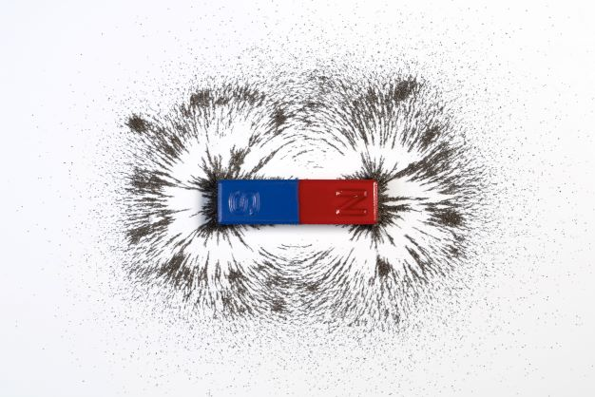
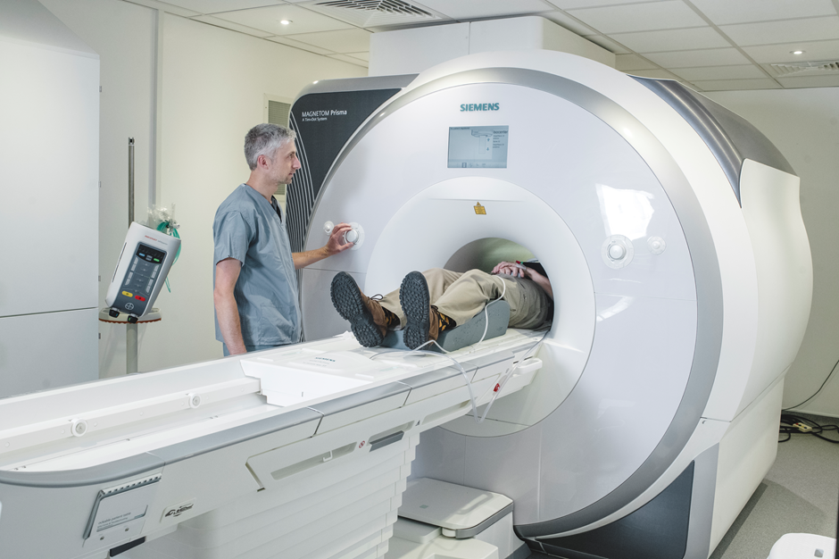
MRI – Magnetic Resonance Imaging
Notes:
It’s all about the magnet!
From NHS website:
Most of the human body is made up of water molecules, which consist of hydrogen and oxygen atoms. At the centre of each hydrogen atom is an even smaller particle called a proton. Protons are like tiny magnets and are very sensitive to magnetic fields.
When you lie under the powerful scanner magnets, the protons in your body line up in the same direction, in the same way that a magnet can pull the needle of a compass. You will not be able to feel this.
Short bursts of radio waves are then sent to certain areas of the body, knocking the protons out of alignment. When the radio waves are turned off, the protons realign. This sends out radio signals, which are picked up by receivers.
These signals provide information about the exact location of the protons in the body. They also help to distinguish between the various types of tissue in the body, because the protons in different types of tissue realign at different speeds and produce distinct signals.
In the same way that millions of pixels on a computer screen can create complex pictures, the signals from the millions of protons in the body are combined to create a detailed image of the inside of the body.

Slide 9
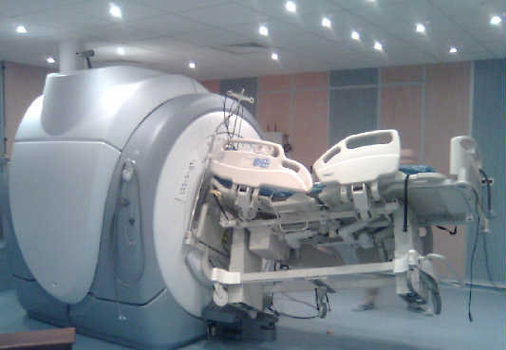
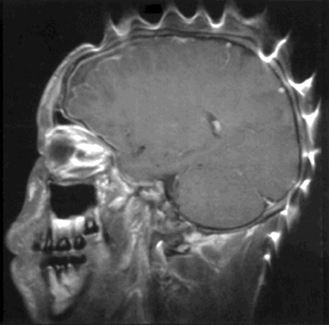
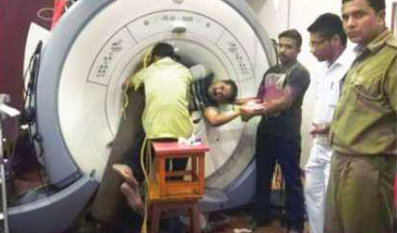
Notes:
It’s a VERY strong magnet! Which is why, if you’ve ever had an MRI, the radiographers will have taken the MRI safety questionnaire you completed very seriously.
How strong is a typical MRI magnet? Most NHS MRIs are measured at 1.5 T (Tesla). The MGNC’s MRI is 3 T.
1 Tesla = 10,000 Gauss
A typical fridge magnet is approx. 100 Gauss, so the MRI at the MGNC is 300x stronger than the magnets on your fridge. By comparison, a neutron star exerts a magnetic field of 1 Billion Tesla.
With magnets of this strength, it’s no surprise that they are sensitive to the presence of metals in unexpected places – such as in hair wax. The image on the right was distorted by iron oxide particles present in the hair wax being worn by this person. This effect can also be seen with eye make-up, nail polish, dentures and hair colour.

Slide 10
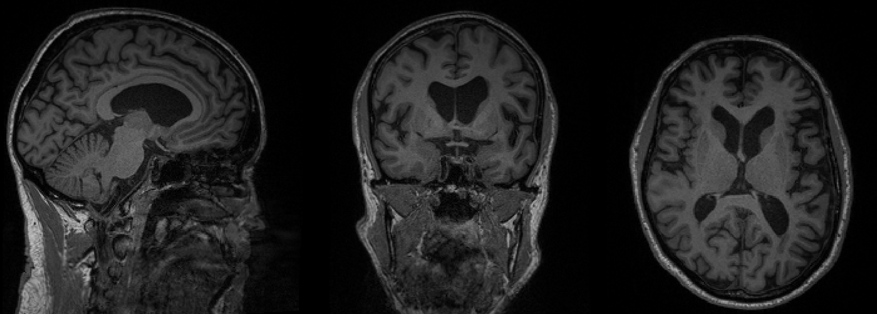
Notes:
From NHS website:
Most of the human body is made up of water molecules, which consist of hydrogen and oxygen atoms. At the centre of each hydrogen atom is an even smaller particle called a proton. Protons are like tiny magnets and are very sensitive to magnetic fields.
When you lie under the powerful scanner magnets, the protons in your body line up in the same direction, in the same way that a magnet can pull the needle of a compass. You will not be able to feel this.
Short bursts of radio waves are then sent to certain areas of the body, knocking the protons out of alignment. When the radio waves are turned off, the protons realign. This sends out radio signals, which are picked up by receivers.
These signals provide information about the exact location of the protons in the body. They also help to distinguish between the various types of tissue in the body, because the protons in different types of tissue realign at different speeds and produce distinct signals.
In the same way that millions of pixels on a computer screen can create complex pictures, the signals from the millions of protons in the body are combined to create a detailed image of the inside of the body.

Slide 11
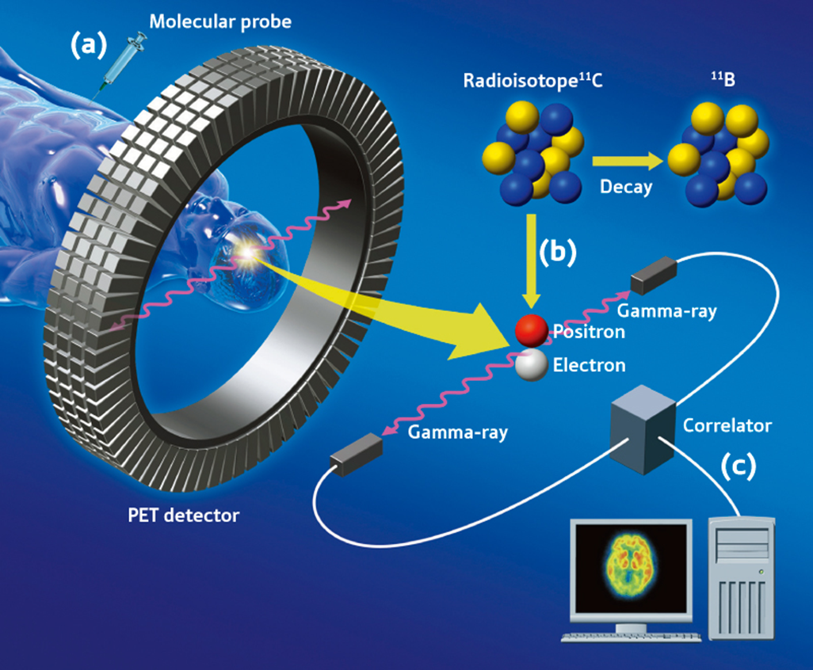
PET – Positron Emission Tomography
Image credit: https://medicalxpress.com/news/2010-09-molecular-imaging-vast-world-neuroscience.html
Notes:
From NHS website:
PET scanners work by detecting the radiation given off by a substance injected into your arm called a radiotracer as it collects in different parts of your body.
In most PET scans a radiotracer called fluorodeoxyglucose (FDG) is used, which is similar to naturally occurring glucose (a type of sugar) so your body treats it in a similar way.
By analysing the areas where the radiotracer does and does not build up, it's possible to work out how certain body functions are working. For example, using FDG in the body's tissues can help identify cancerous cells because they use glucose at a much faster rate than normal cells.
PET is a molecular imaging technique which employs the use of selective radioligands to investigate molecular targets in vivo by measuring the distribution of a radioactive tracer.
A radiopharmaceutical which is labelled with a position-emitting radionuclide is injected into patient to image a specific target or biological process.
The radioactive atom of the radiotracer emits positrons. The emitted positron combined with an electron after travelling a distance within the tissue.
The positron and electron are then converted into 2 photons which are emitted in nearly opposite direction.
Photon detectors in the PET scanner detect millions of coincidence detections throughout the scan which provide information about the distribution of the tracer in the tissue.
There are different types of acquisition, depending on the tracer and study protocol for data analysis, (1) the tracer is injected to the subject outside scanner, with a set, predetermined uptake period followed by static acquisition over set time; (2) the patient is injected on the scanner bed and image acquisition begins upon tracer injection so the tracer radioactivity is monitored continuously during the course of the scan to observe the long-term behaviour of the tracer in tissue.

Slide 12
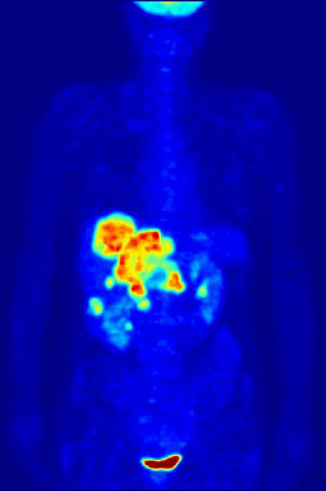
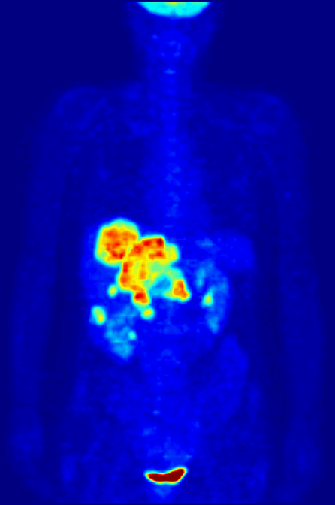
Image credit: Jens Maus (http://jens-maus.de/) - Own work, Public Domain, https://commons.wikimedia.org/w/index.php?curid=801896

Slide 13
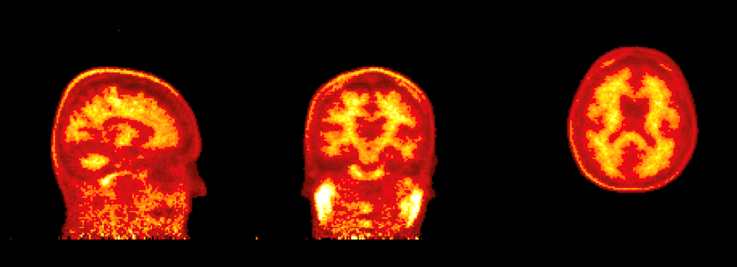

Slide 14

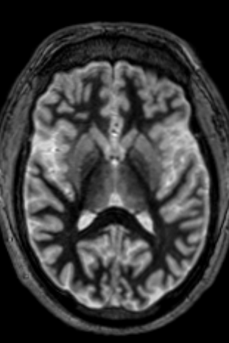
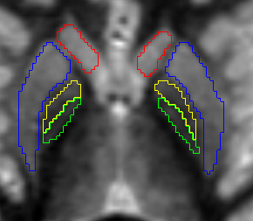
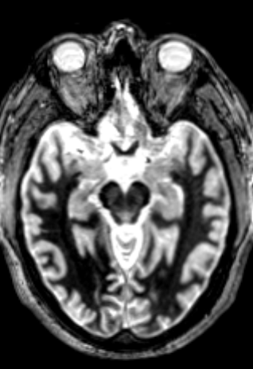
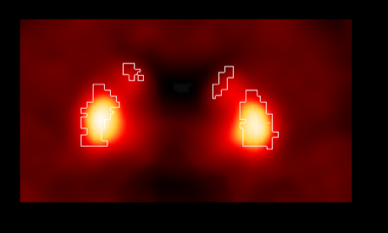
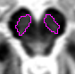
Notes:
PET data is usually acquired alongside structural MRI to aid delineation of anatomical regions of interest and quantify tracer concentration within specific regions of interest, as well as to support co-registration steps in the PET processing pipeline.

Slide 15
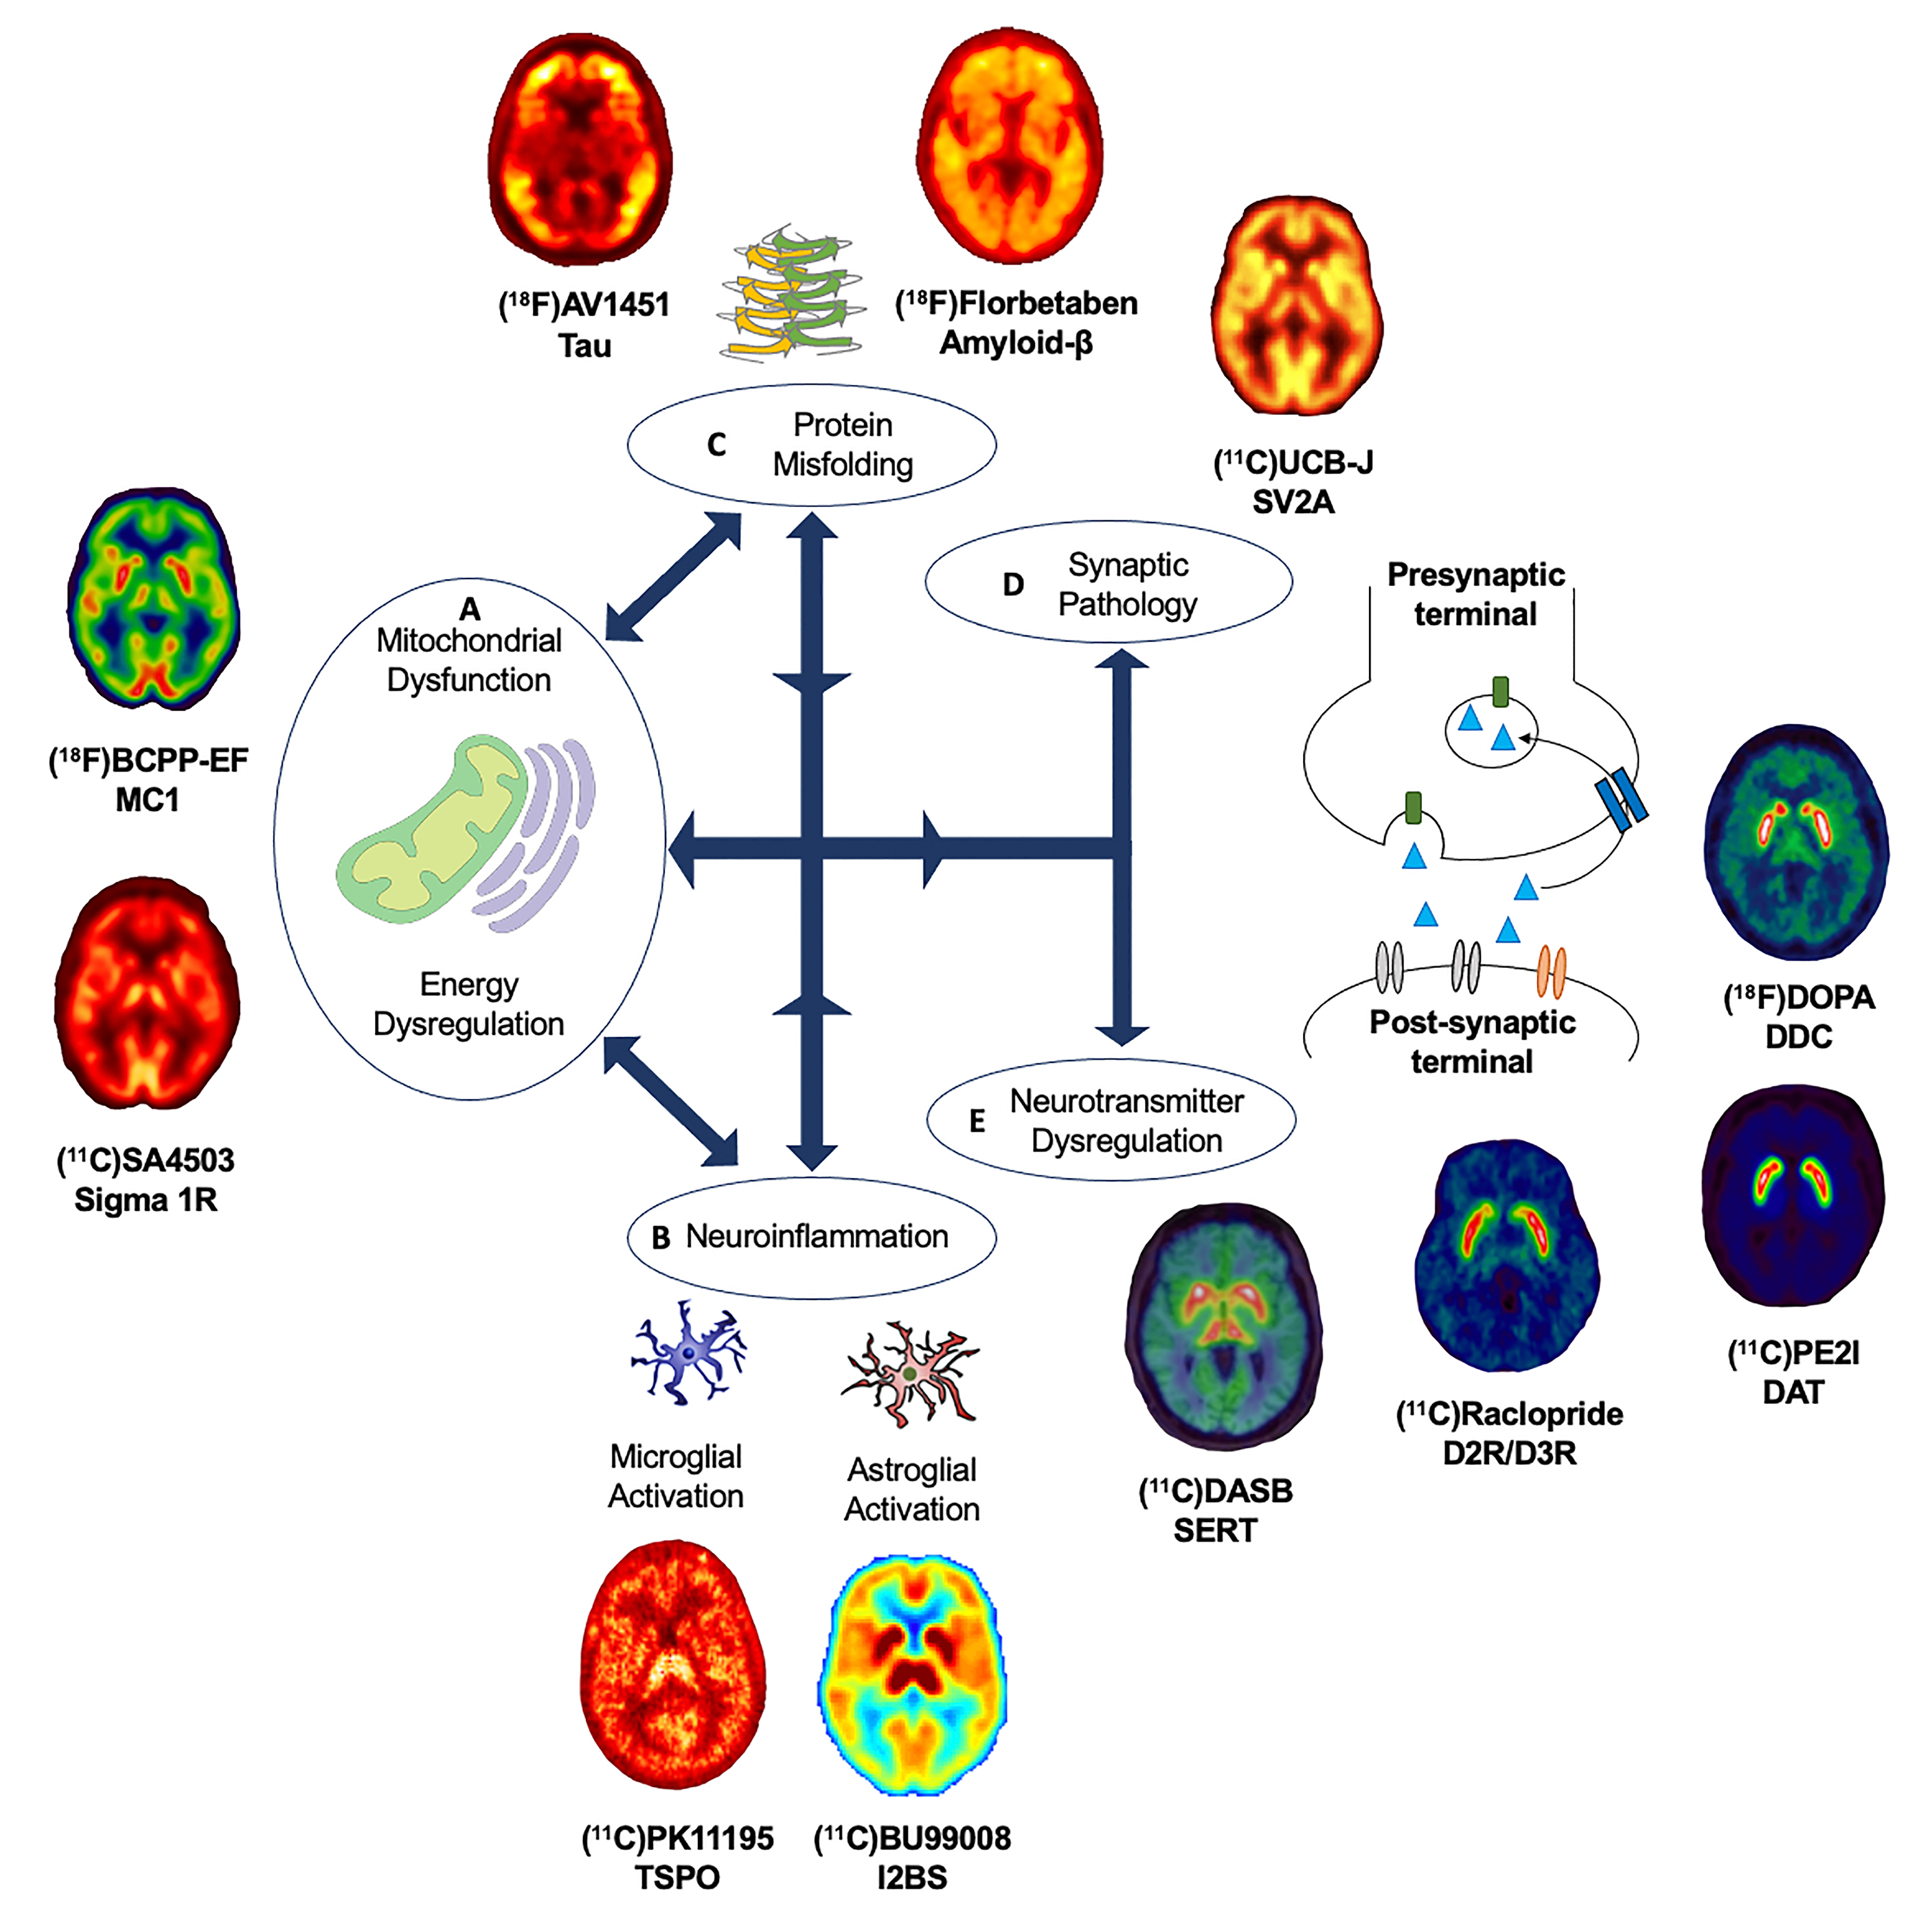
Clinical symptoms:
Motor symptoms
Non-motor symptoms:
Sleep
Autonomic dysfunction
Behavioral symptoms
Executive functions
Episodic memory
Semantic memory
Language
Visuospatial functions
Notes:
A typical PET study will attempt to look for associations between the uptake of a specific radioligand, for a target of interest, and clinical symptoms which are related to the disease so we can link pathology with clinical outcomes.
There are several PET tracers which have been developed to study different molecular and cellular pathways in vivo.

Slide 16
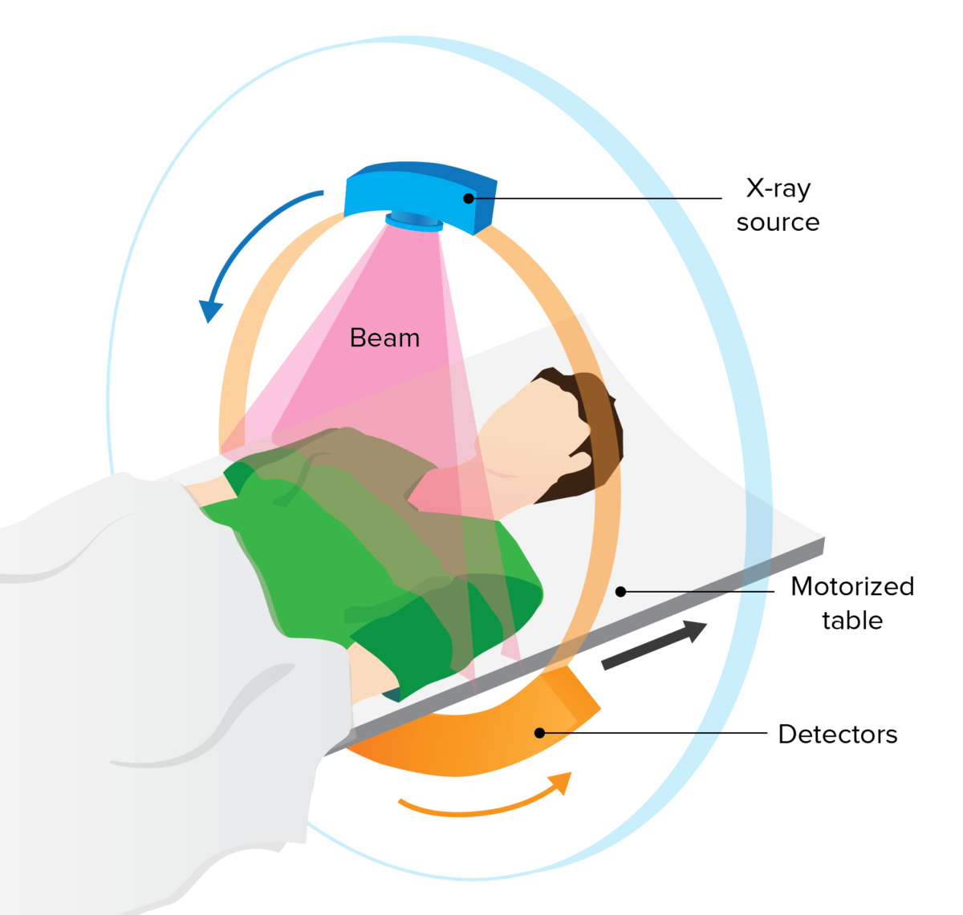
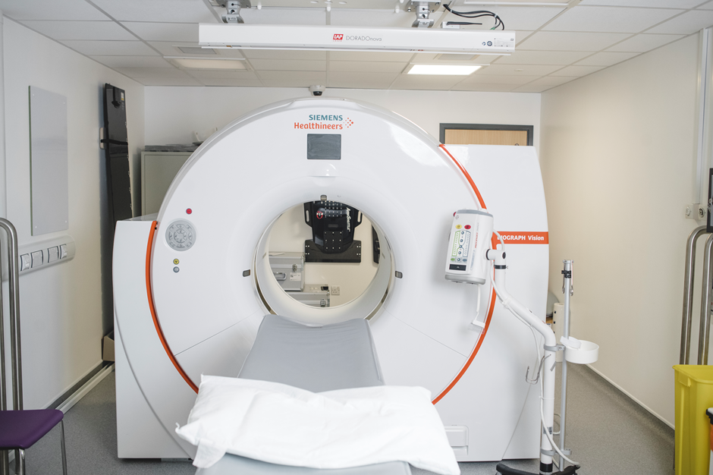
CT – computerised tomography
Image credit: Lecturio
Notes:
CT scans are made by rotating a thin X-ray beam around the body. The CT takes 100s of these x-ray ‘slices’, which can be stitched together in a computer to create 3-D images of the internal structures of the body.
Sometimes you are asked to drink, or are injected with a contrast dye, which allows certain areas of the body to show up more clearly on the scan. E.g. iodine can reveal the outline of blood vessels, and barium can highlight the outline of the digestive system, which may help in identifying tumours.
CT x-rays are more powerful than a standard x-ray, and can provide a higer resolution image of the inside of the body. The 3-D images provided by a CT make it easier to see abnormalities in the body.
CTs are good for showing up bones, blood vessels and organs, but they are less good at capturing the fine details of soft tissue. This is better captured by an MRI.

Slide 17
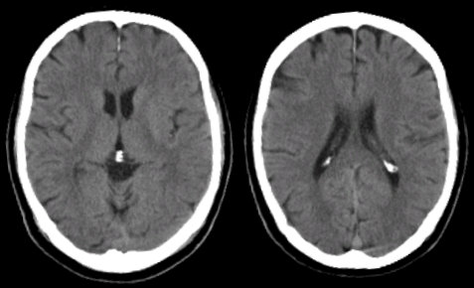
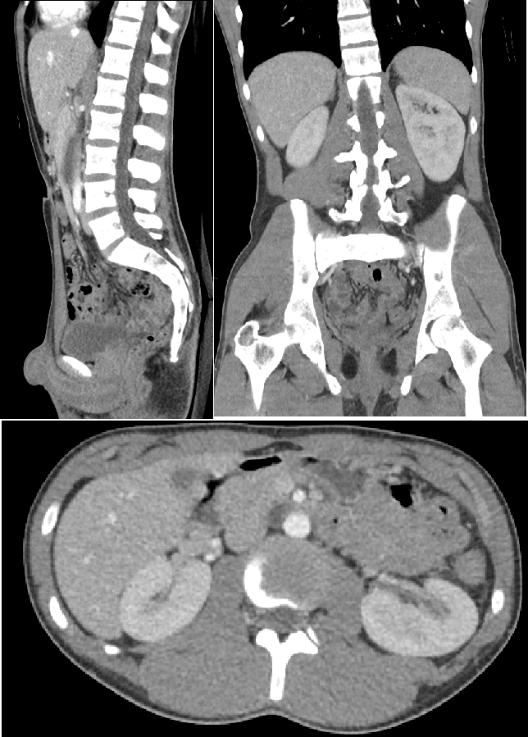
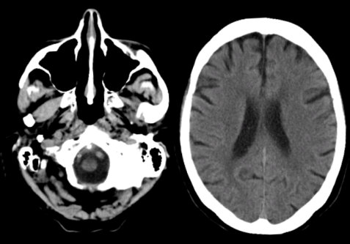
Image credit: Mikael Häggström, M.D. Own work, CC0, https://commons.wikimedia.org/w/index.php?curid=77751764
Image credit: https://case.edu/med/neurology/NR/CT%20Basics.htm

Slide 18
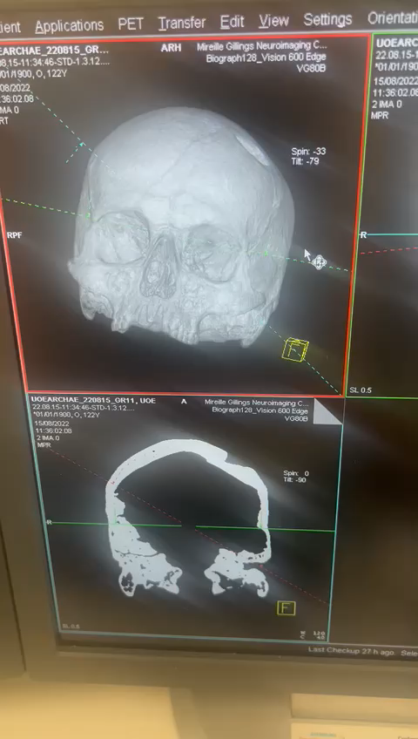

Slide 19
Research at the MGNC
PET studies
Neurodegenerative illnesses: Alzheimer’s, Parkinson’s and Dementia
  Biomarkers, immune system response and neuroinflammation, genetic factors
Long COVID
Imaging methods for people with metal joint replacements
MRI studies
Currently supporting studies covering conditions such as long COVID, kidney disease, multiple sclerosis, eating disorders, nutritional supplements and muscle strength, body image disorders and scoliosis.
Notes:
Aim: to understand the risk factors for Alzheimer’s Disease by creating a database of different measures taken from people at risk of Alzheimer's disease.
This is an example of a study at the centre which is a multi-centre observational study in participants aged ≥ 60 years with prodromal/preclinical Alzheimer’s disease, defined as absence of dementia but with evidence AD pathology as assessed using PET or CSF Aß levels; and control participants without AD pathology on PET imaging or CSF analysis, in a 4:1 ratio.
Highlights the application of amyloid PET to screen and stratify subjects and combined with various MRI sequences to explore disease related changes at longitudinal follow-up in a clinical research study.

Slide 20
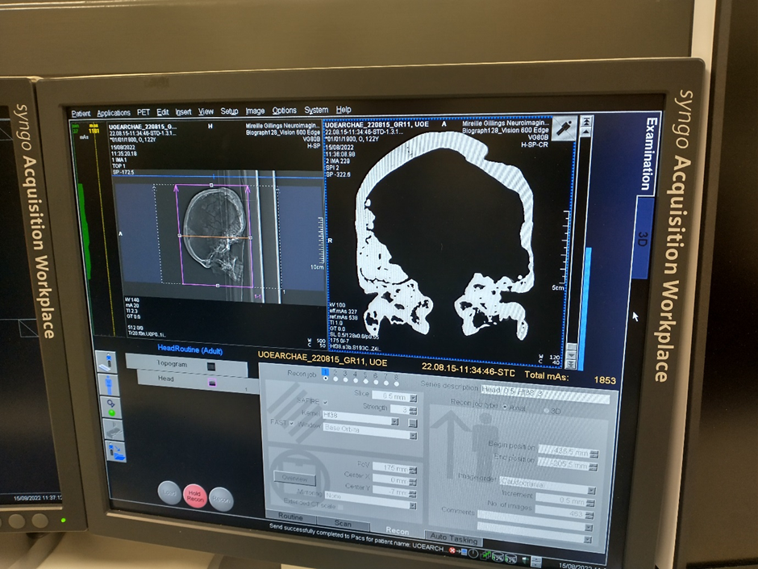
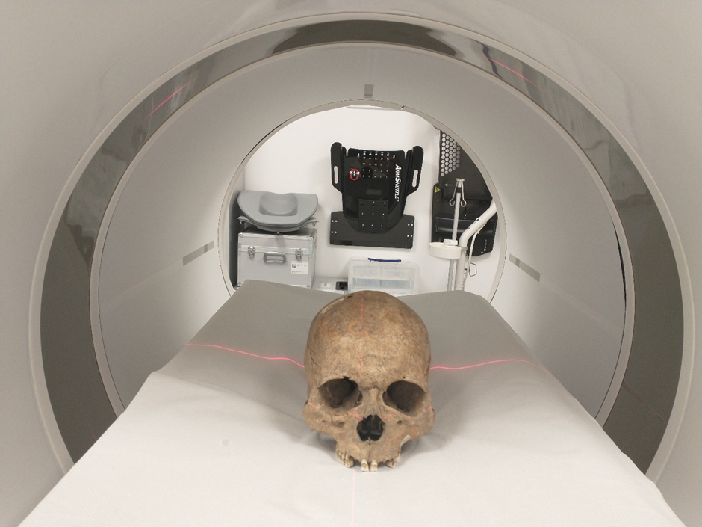
Not just neuroimaging…

Slide 21
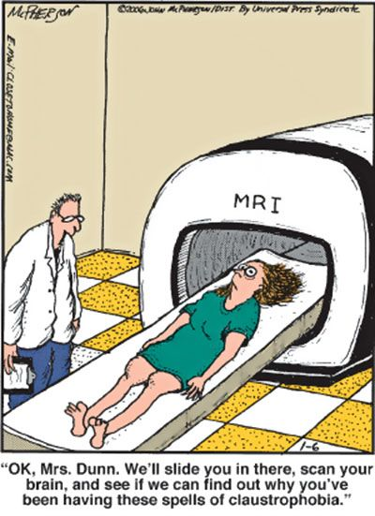
Thank you
Email us:
mgnc@exeter.ac.uk
Twitter:
@Exeter_MGNC

